Slide 1
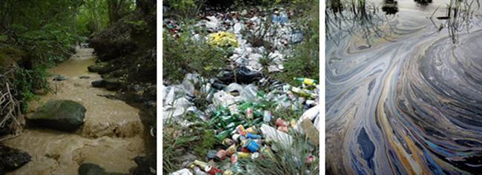
Municipal Requirements
What is the role of the municipality in stormwater compliance, and why?
Public Education and Outreach
Sponsored by STORM
March 6, 2019

Slide 2
Municipal Requirements
Cities apply for coverage under an MS4 permit through ADEQ to discharge stormwater (NOI) and may terminate coverage (NOT)
Cities are required to adopt and implement local ordinances or other regulatory mechanisms that provide adequate enforcement procedures to control discharges into the MS4
Notes:
Just like your NOI this permit allows municipalities to discharge water to a water of the US by means of conveyance, but only if we meet a specific set of requirements and take actions to reduce any potential impacts of pollution to the water

Slide 3
Municipal REQUIREMENTS
At a minimum
    prohibit connections
    control spills
    prohibit disposal of materials
    require compliance with ordinances (permits, contracts, orders)
Notes:
Kellie

Slide 4
Municipal Requirements
Minimum Requirements Cont’d
    To the extent allowable under State law have methods to enter private property to inspect for compliance, and
    Require violators to cease and desist, clean up, or abate unlawful discharge or be cited with civil or criminal sanction
    Require owners/operators of construction activities to minimize the discharge of pollutants to the MS4
Notes:
This is just a sampling of the requirements, but today we will focus on the parts that relate to your industry. In fact we have an entire section of requirements pertaining to just construction (next slide)

Slide 5
Municipal Requirements for construction
Construction Activity Stormwater Runoff Control
    Minimize or eliminate pollutant discharges to the MS4
    Require sediment and erosion control
    Maintain inventory of activities
    Document inspections and enforcement
    Have written procedures for site plan review
    Train staff
    Provide education to construction activity operators
Notes:
through the installation, implementation, and maintenance of stormwater control measures…

Slide 6
Municipal Requirements
Municipalities must also have the following information available to the public
    Departments, roles, responsibilities, and up-to-date org chart
    Documented local administrative and legal procedures
    A plan on how it will exercise its legal authority – referred to as an Enforcement Response Plan
Notes:
Kellie

Slide 7
Municipal Variabilities
Some municipalities have a shop of one; some, have 10, 50, 70
In a smaller city, everything may be managed by Public Works or Streets
In another, it could be Planning and Development
Notes:
Kellie

Slide 8
Municipal Variabilities
Monitoring stormwater protection controls may be the job of city offsite inspectors or engineering inspectors
Other cities will have a specific inspector that comes out just to review your SWPPP and BMP’s
Notes:
Kellie

Slide 9
Construction Requirements:
SWPPP
A Stormwater Pollution Prevention Plan is required to obtain an NOI from ADEQ this plan must include:
    Include all potential sources of pollution
    Describe and ensure implementation of control measures
    Identify the responsible person for on-site implementation

Slide 10
What to
Expect
Always have your NOI and SWPPP onsite and up to date wherever you are in the valley
    Required Signage
    Updated paperwork
No matter who performs the work there is an interested public and these are requirements in the AZPDES General Permit
Notes:
Kellie

Slide 11
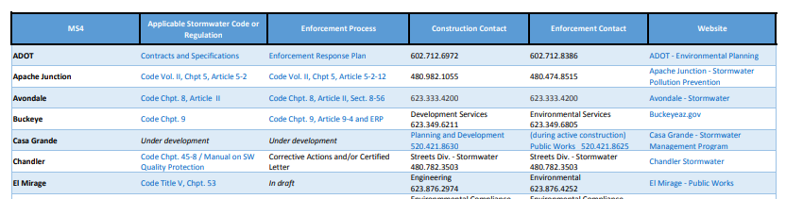
Visit
AZSTORM.org
For a listing of Ordinances, contact information, and enforcement processes of our member MS4s from around the valley
Notes:
Kellie

Slide 12
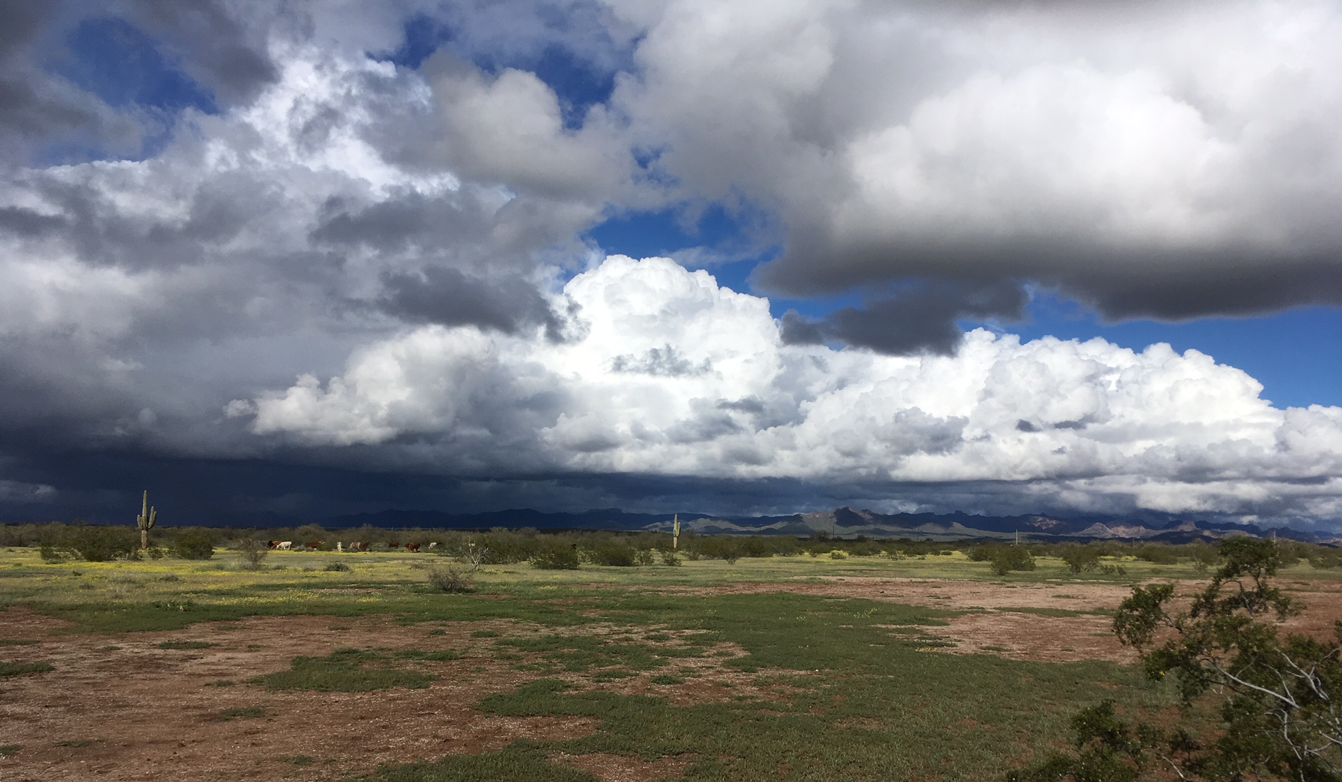
Stormwater Construction
Best Management Practices (BMP)
Tutorial

Slide 14
A.R.S. 49-255.01 (L.) – AZ Pollution Discharge Elimination System Program
L. When developing a general permit for discharges of storm water from construction activity, the director shall provide for reduced control measures at sites that retain storm water in a manner that eliminates discharges from the site, except for the occurrence of an extreme event. Reduced control measures shall be available if all of the following conditions are met:
1. The nearest downstream receiving water is ephemeral and the construction site is a sufficient distance from a water warranting additional protection as described in the general permit.
2. The construction activity occurs on a site designed so that all storm water generated by disturbed areas of the site exclusive of public rights-of-way is directed to one or more retention basins that are designed to retain the runoff from an extreme event. For the purposes of this subsection, "extreme event" means a rainfall event that meets or exceeds the local one hundred-year, two-hour storm event as calculated by an Arizona registered professional engineer using industry practices.
3. The owner or operator complies with good housekeeping measures included in the general permit.
4. The owner or operator maintains the capacity of the retention basins.

Slide 15
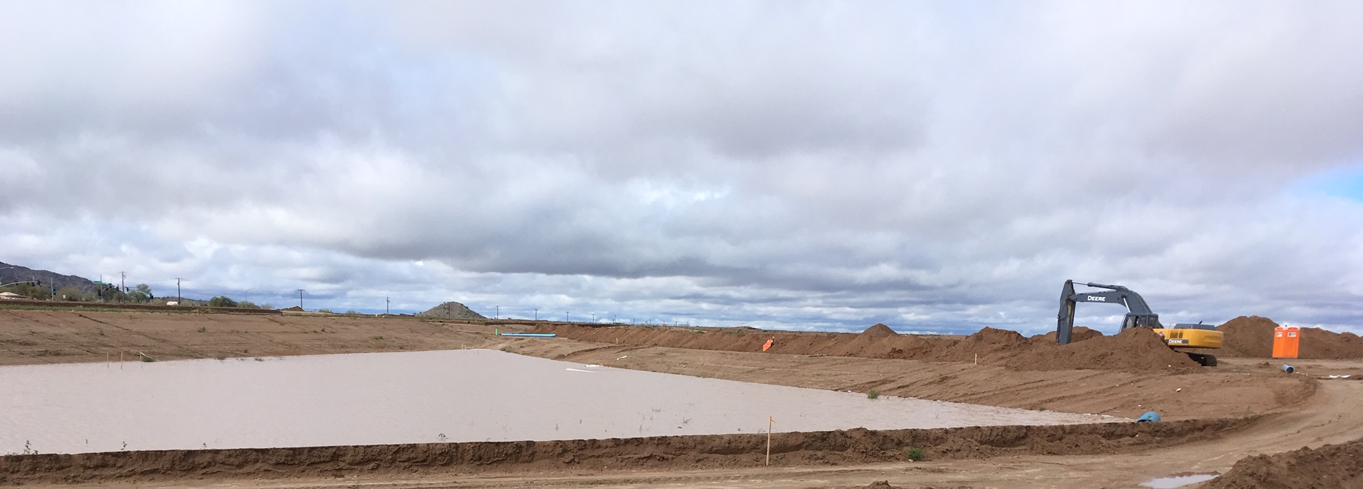

Slide 16
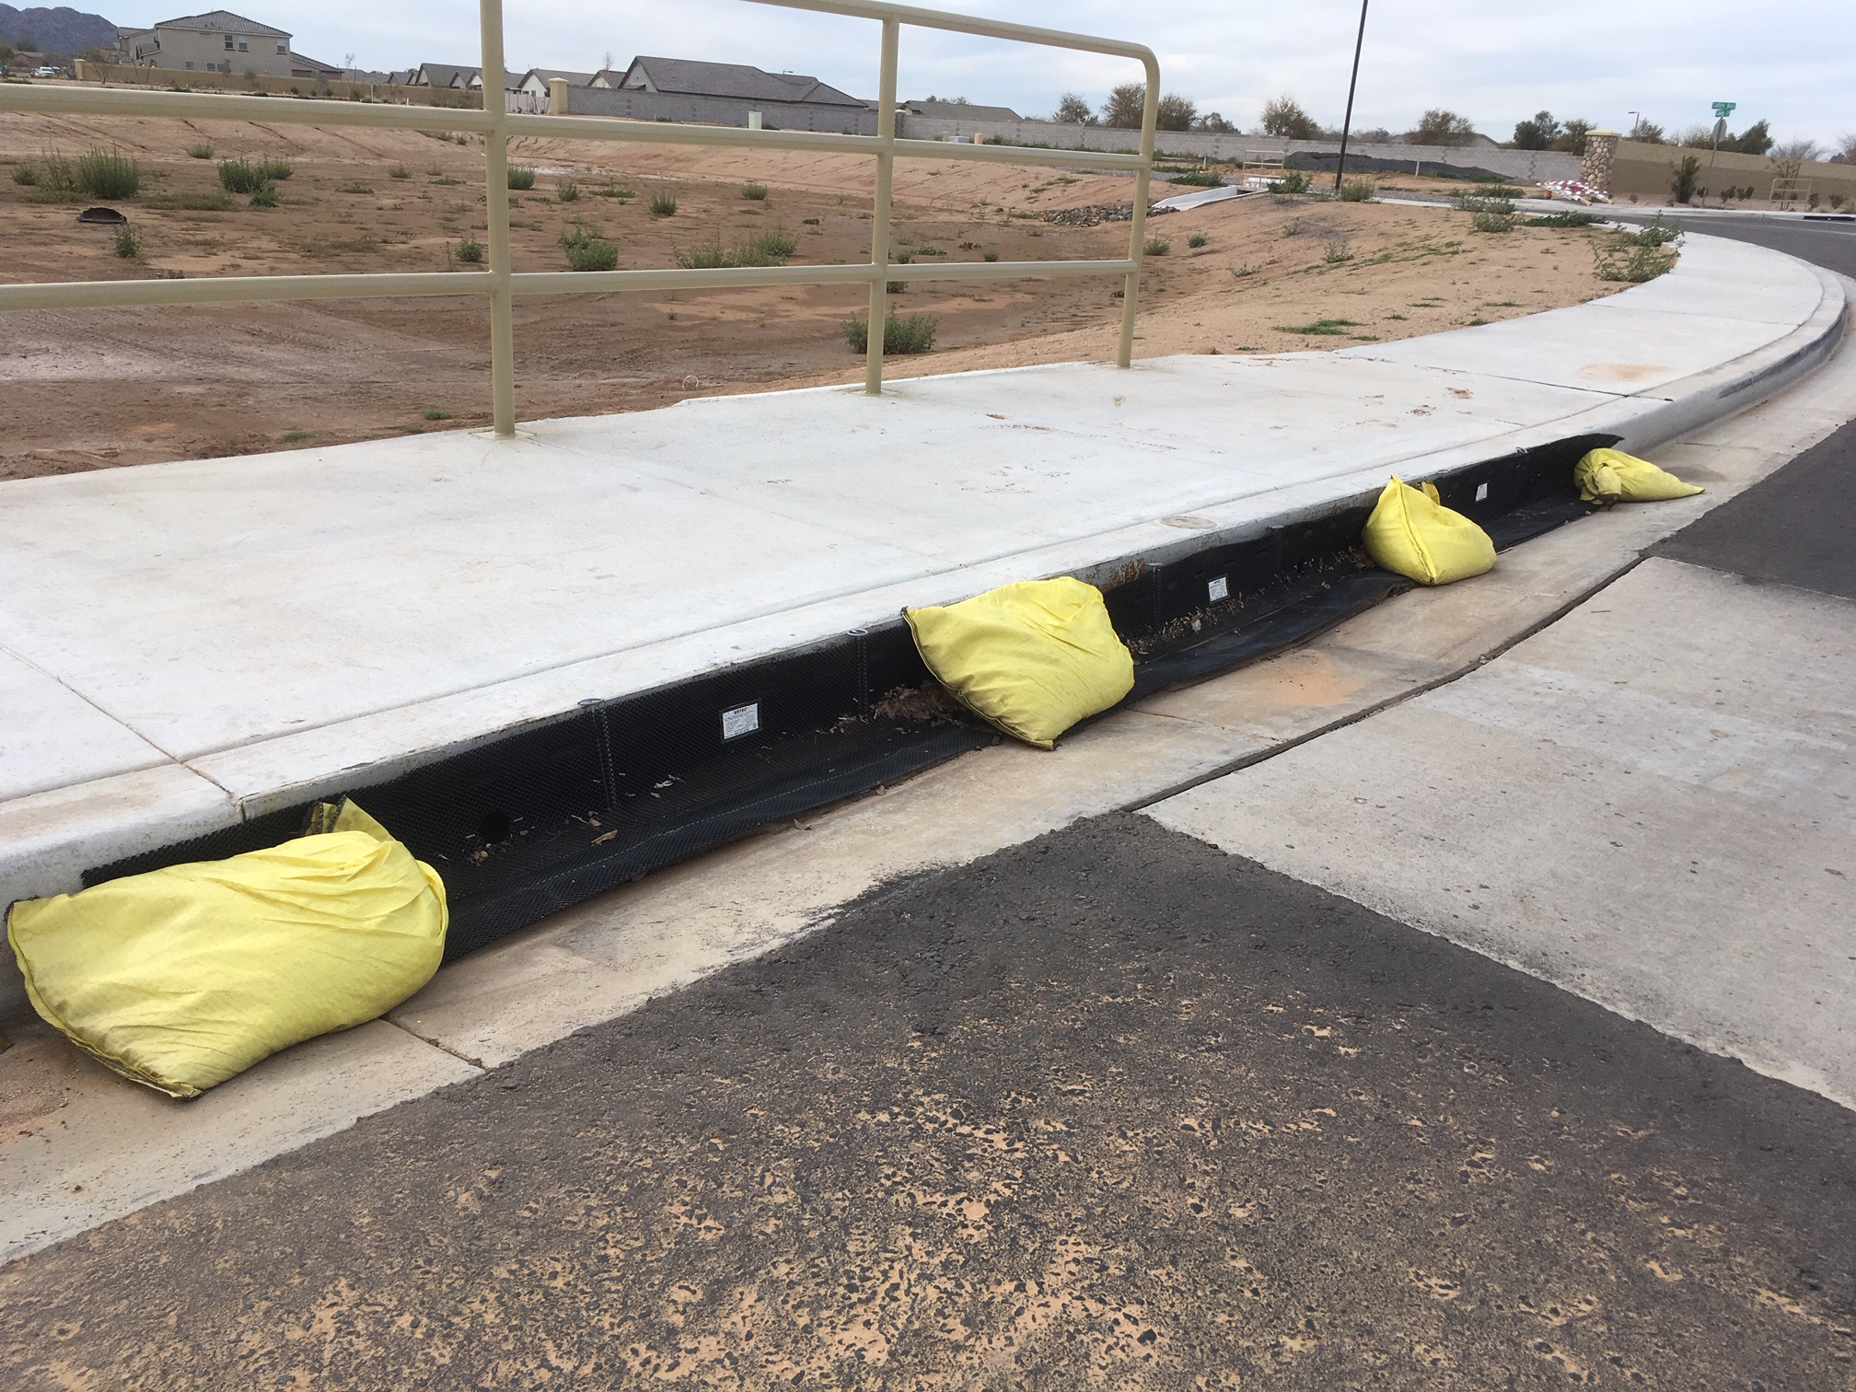

Slide 17
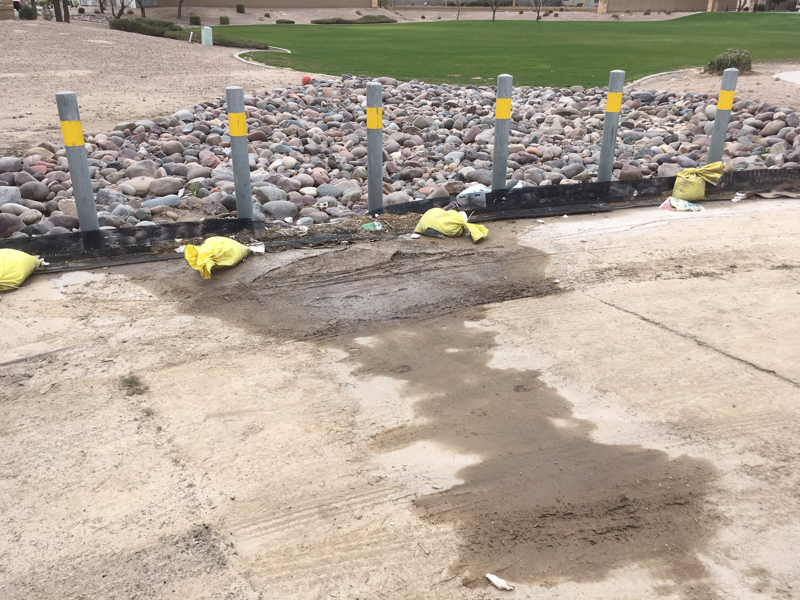

Slide 18
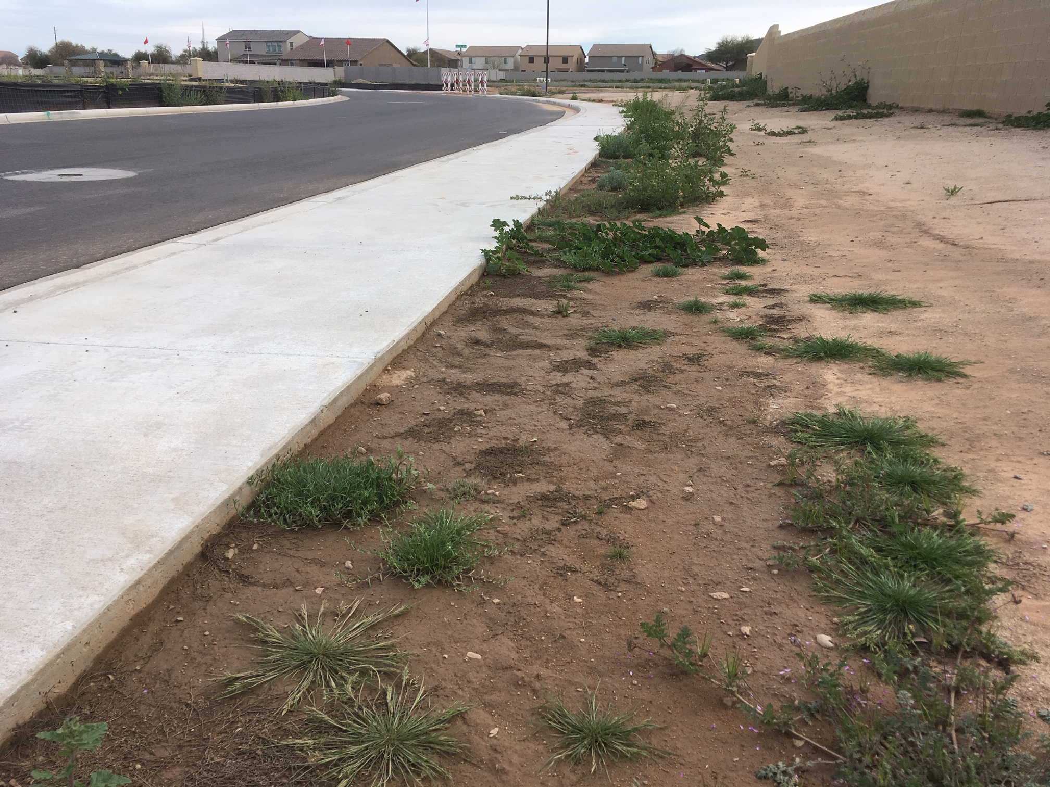

Slide 19
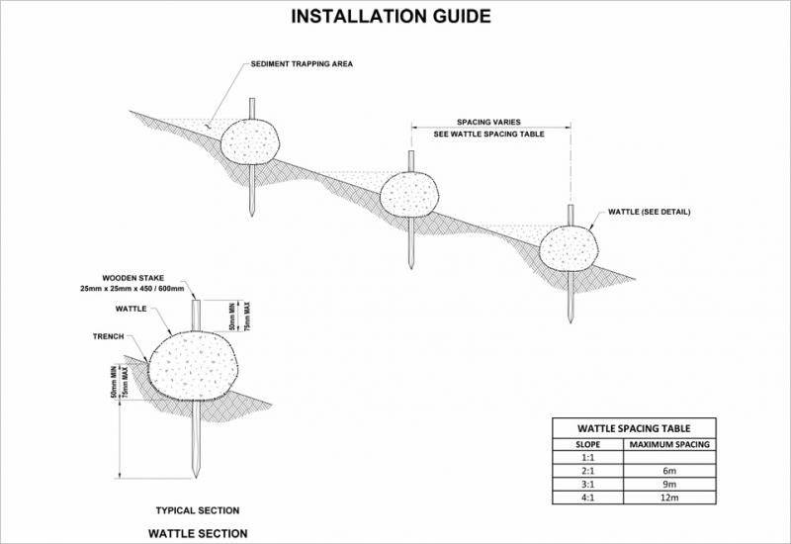
Wattles

Slide 20
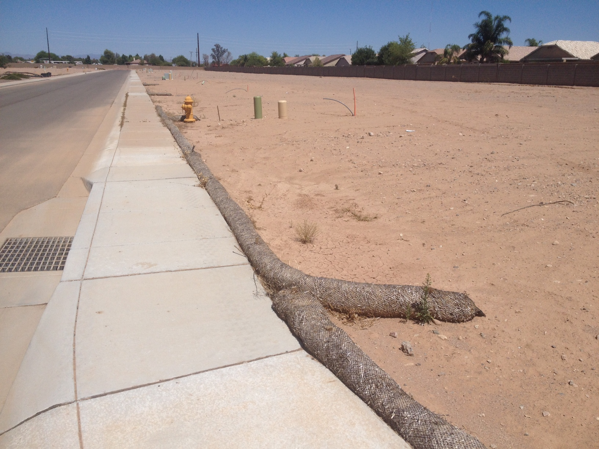
Wattles
+ Staked down
+ Good ground
contact
+ Placed at low
end of site

Slide 21
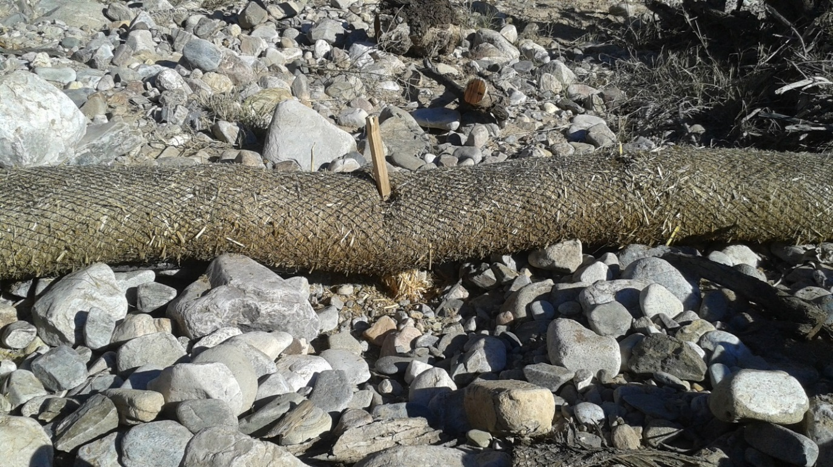
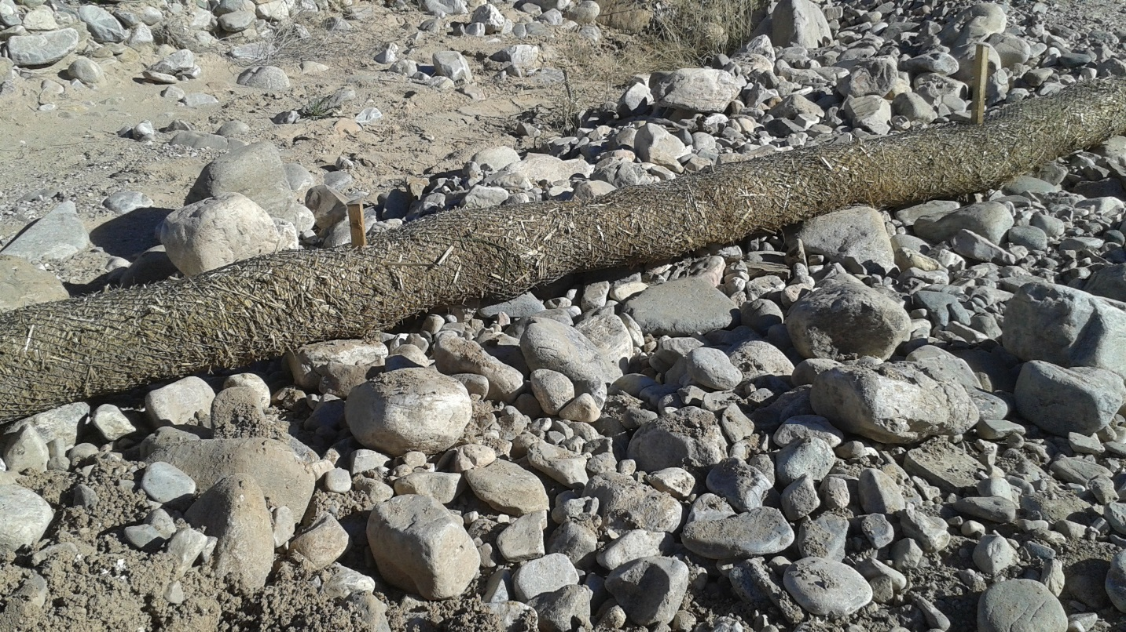
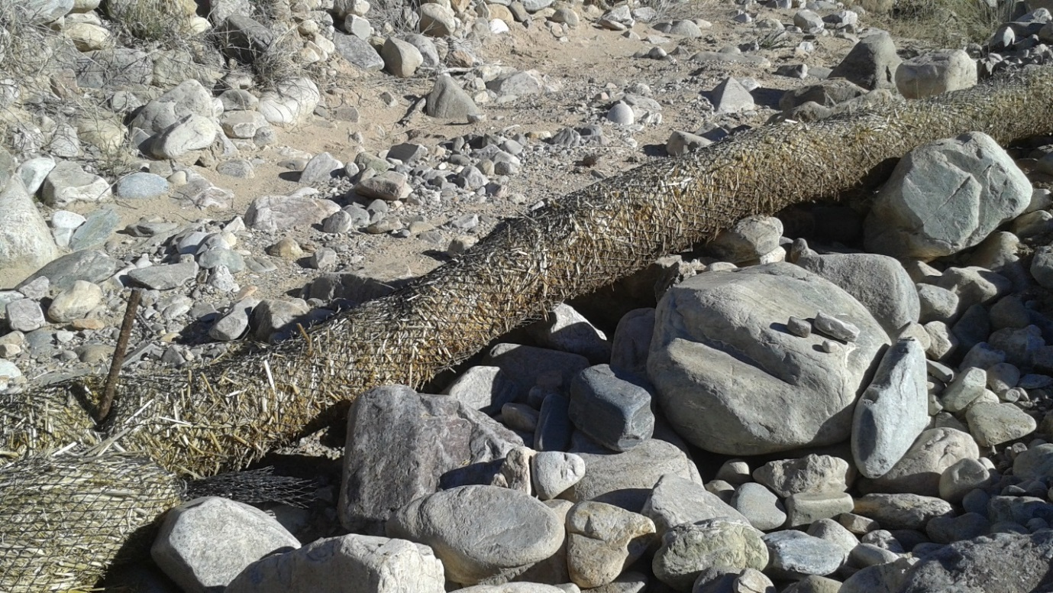

Slide 22
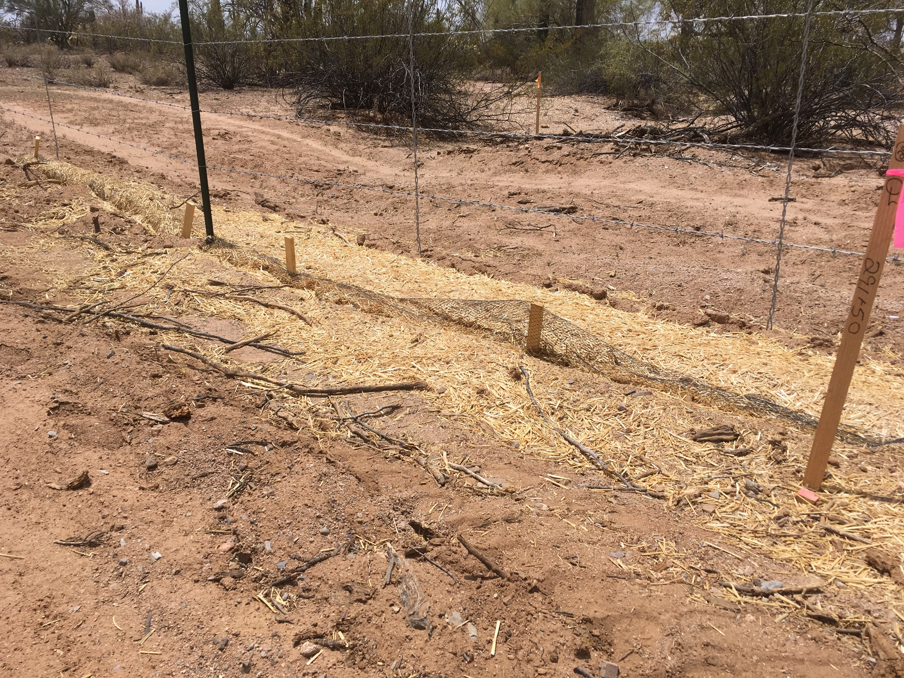
Critter damage

Slide 23
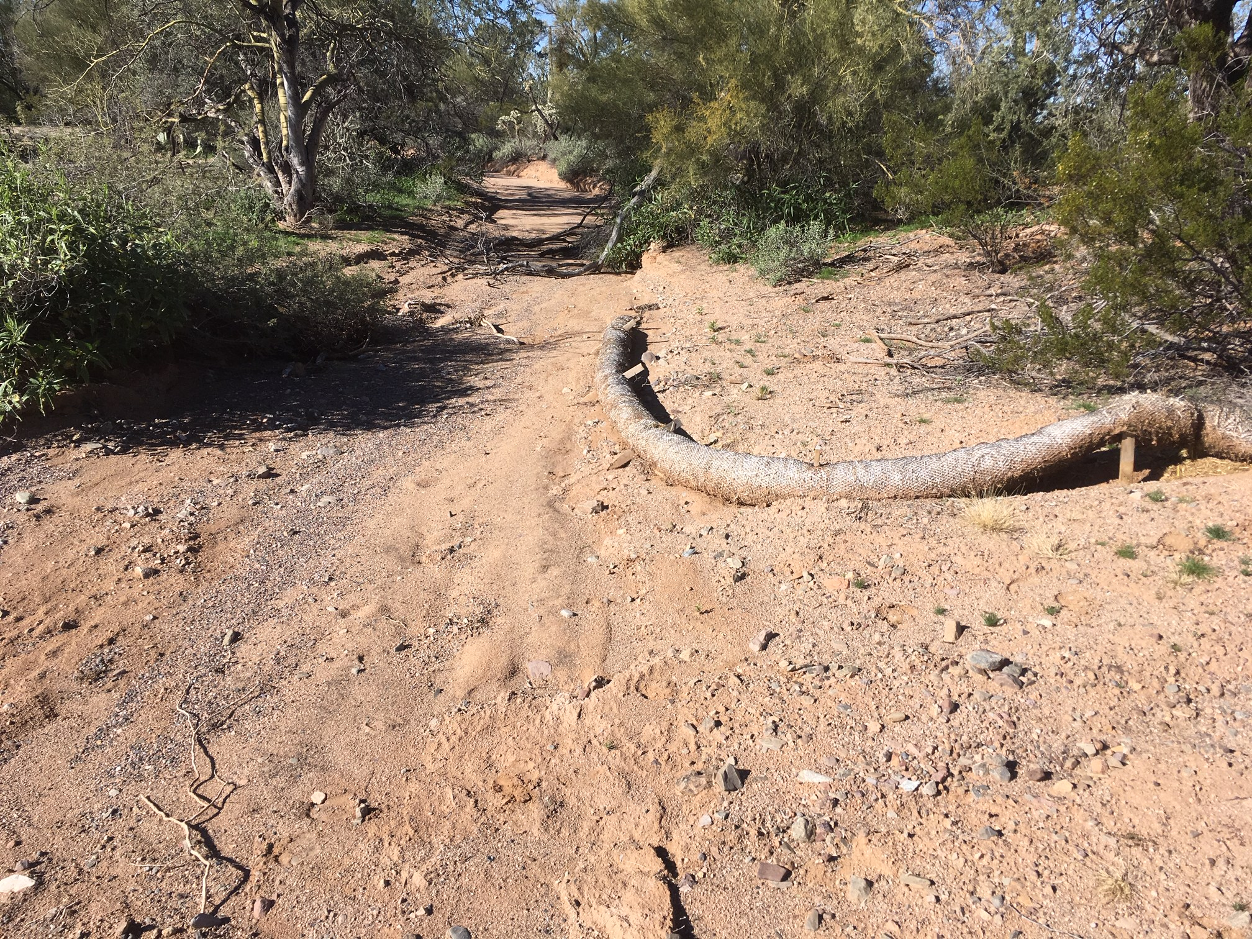

Slide 24
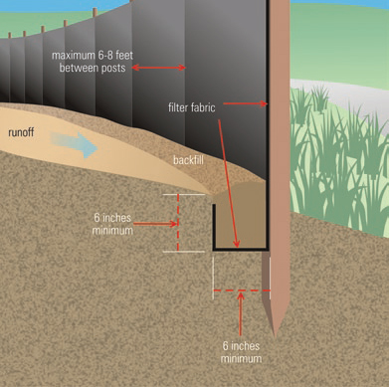
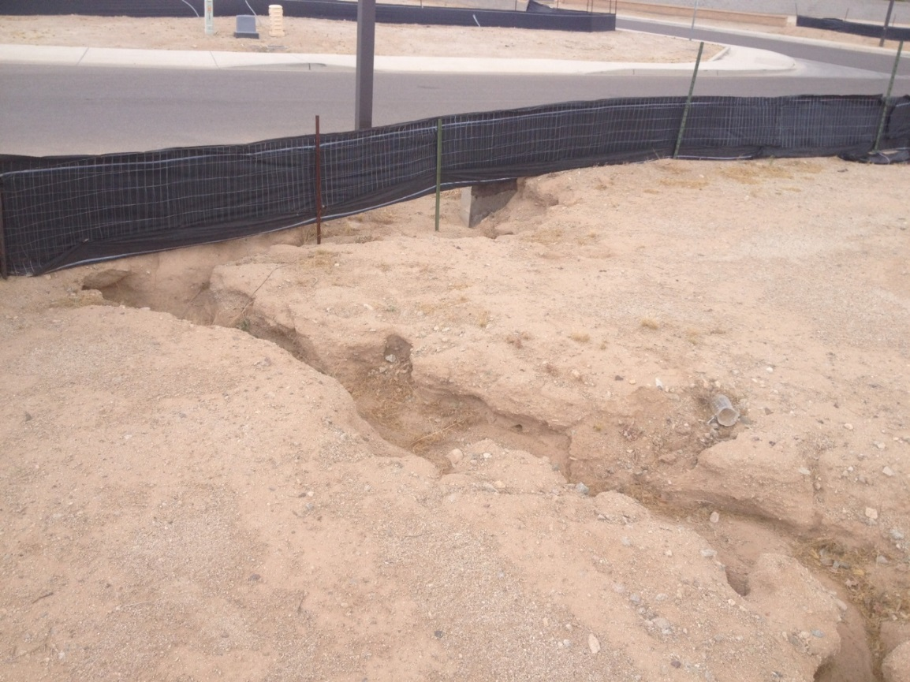
Silt Fence
Maximum Area < ¼ acre per 100 ft. of silt fence

Slide 25
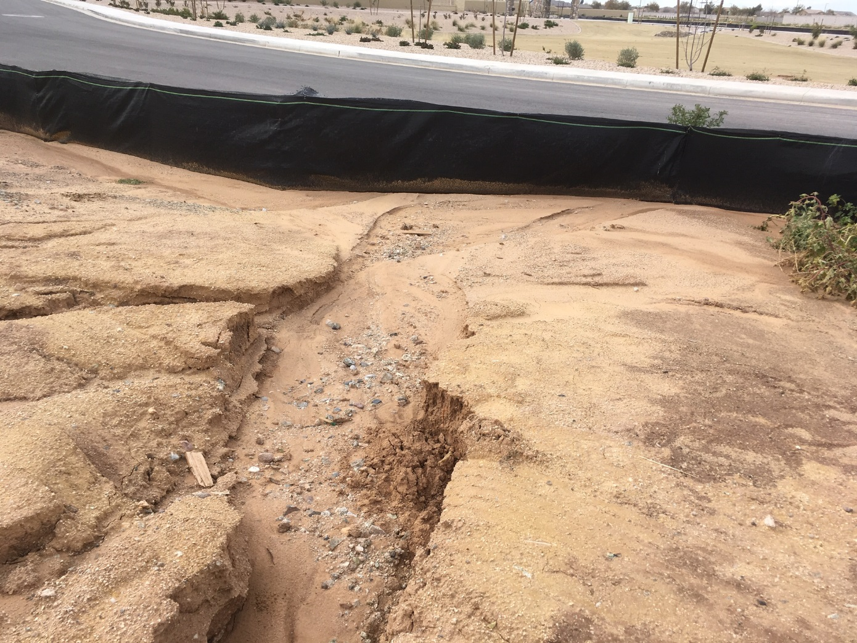
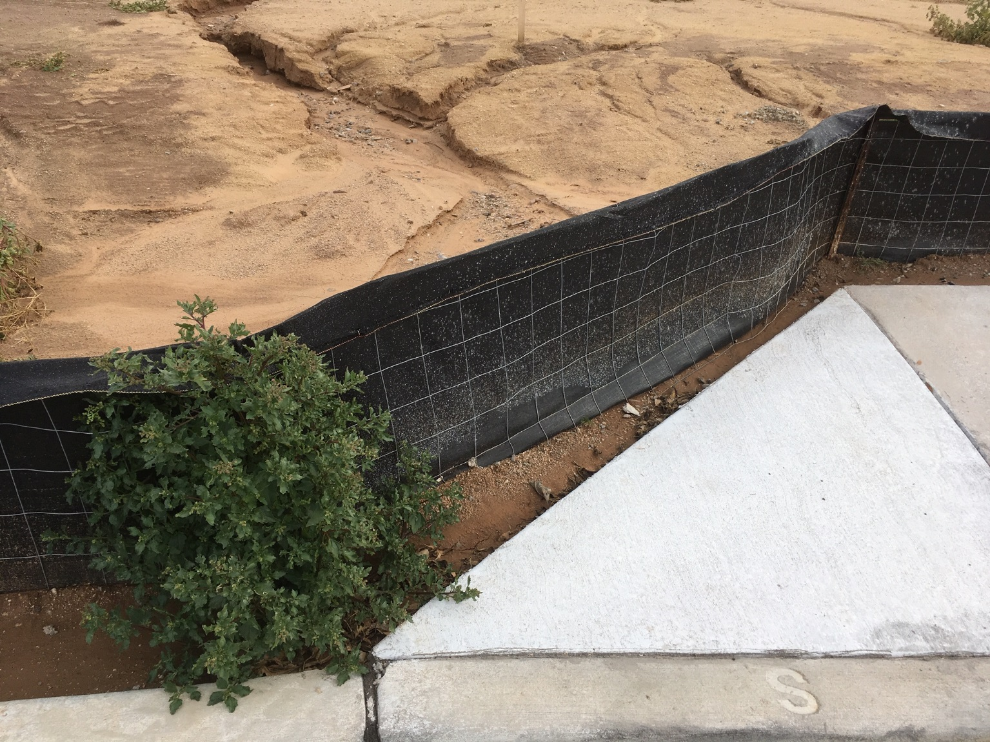

Slide 26
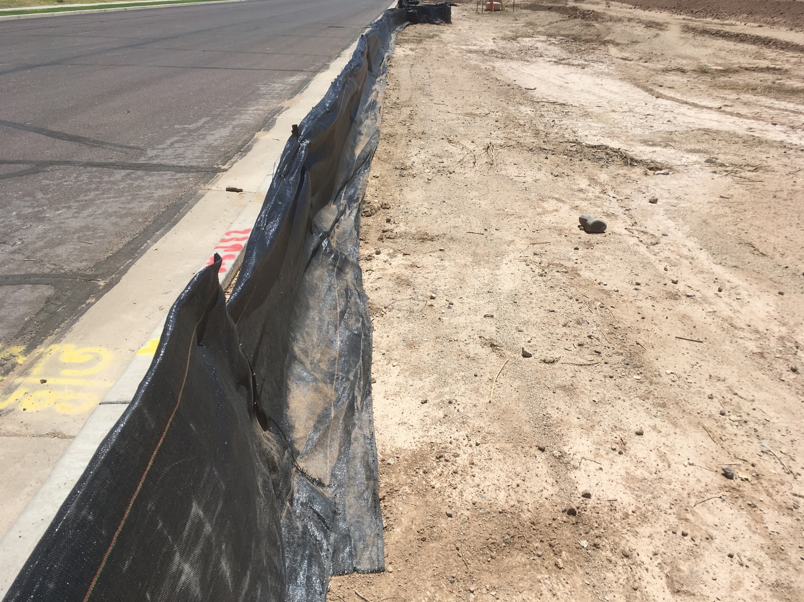

Slide 27
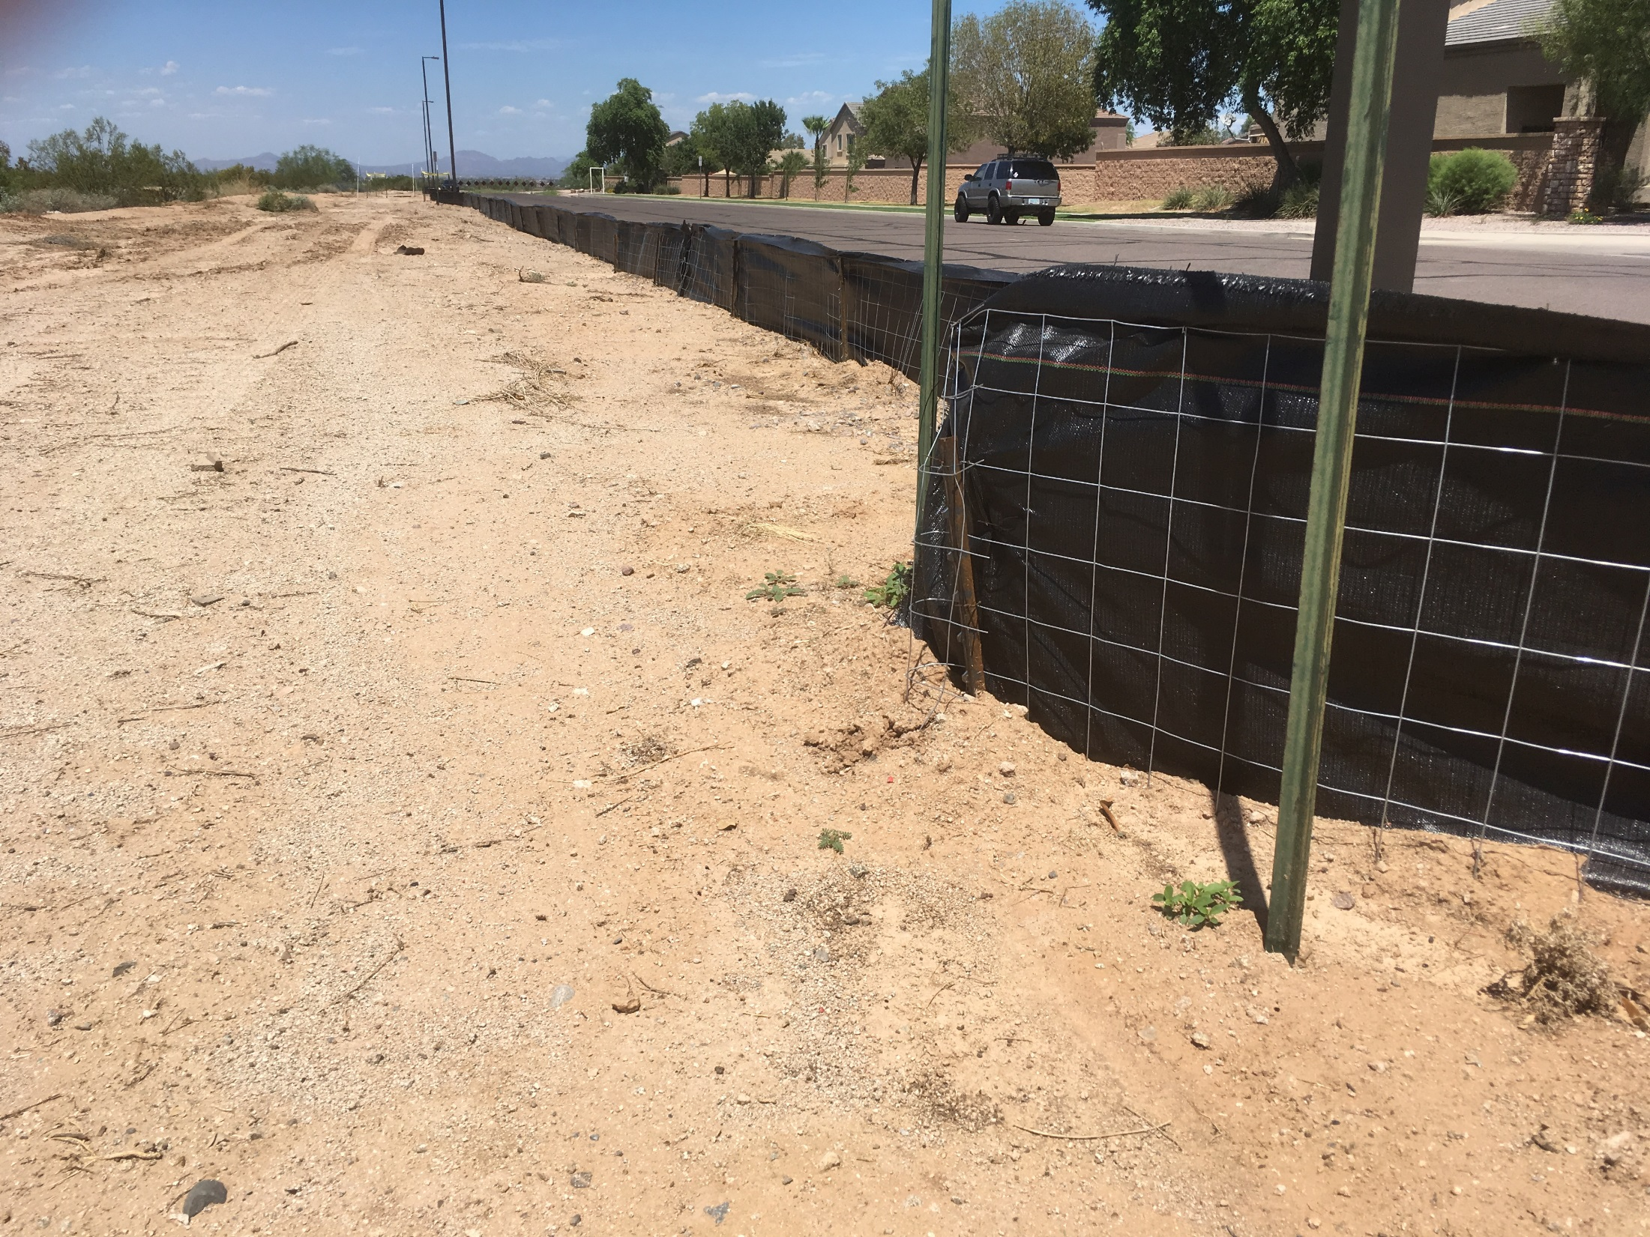

Slide 28
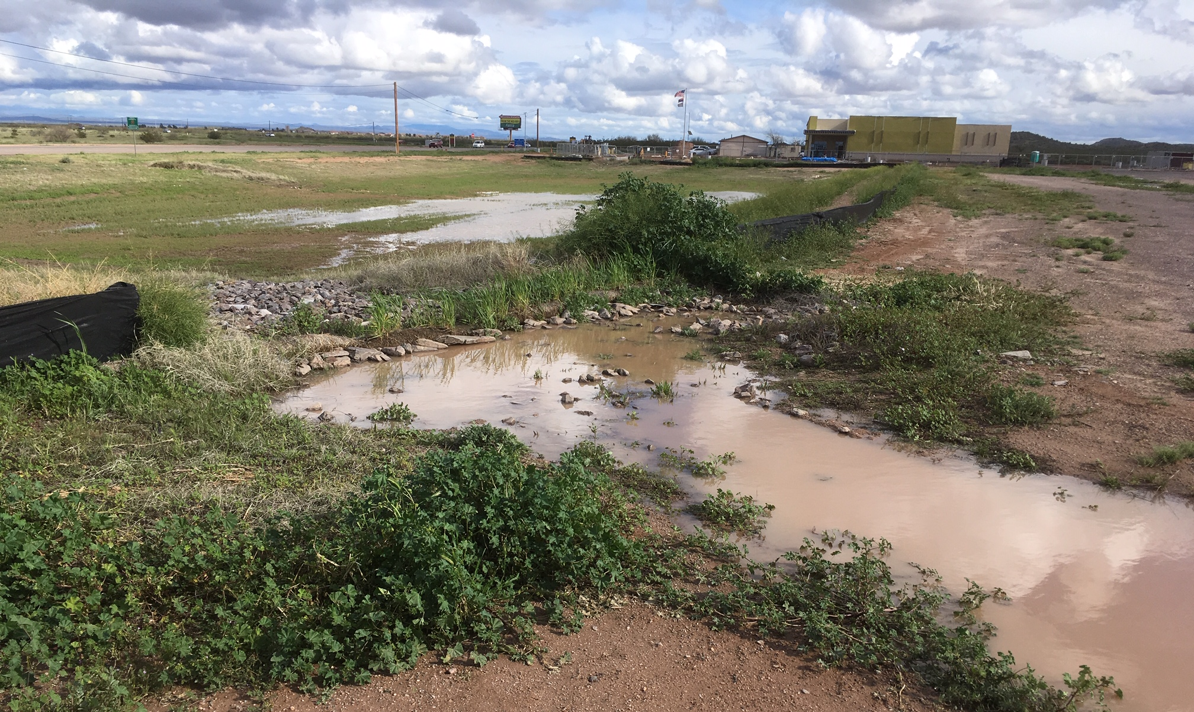

Slide 29
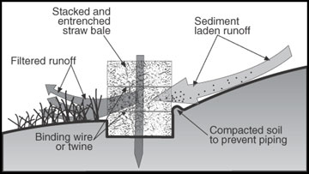
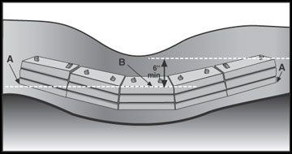
Straw Bale Barrier

Slide 30
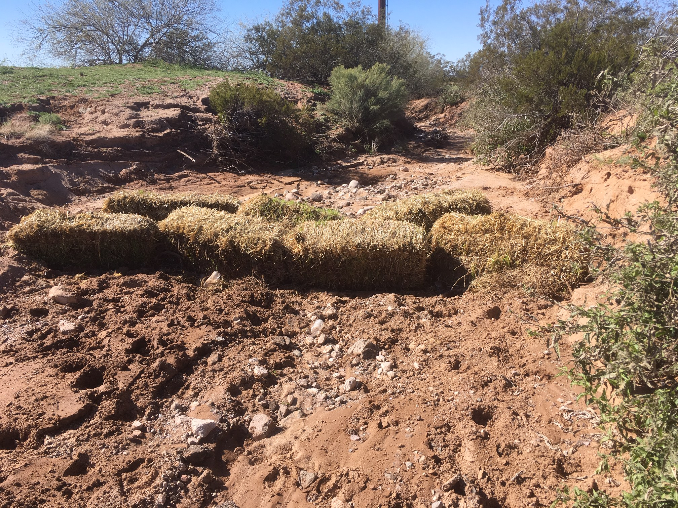

Slide 31
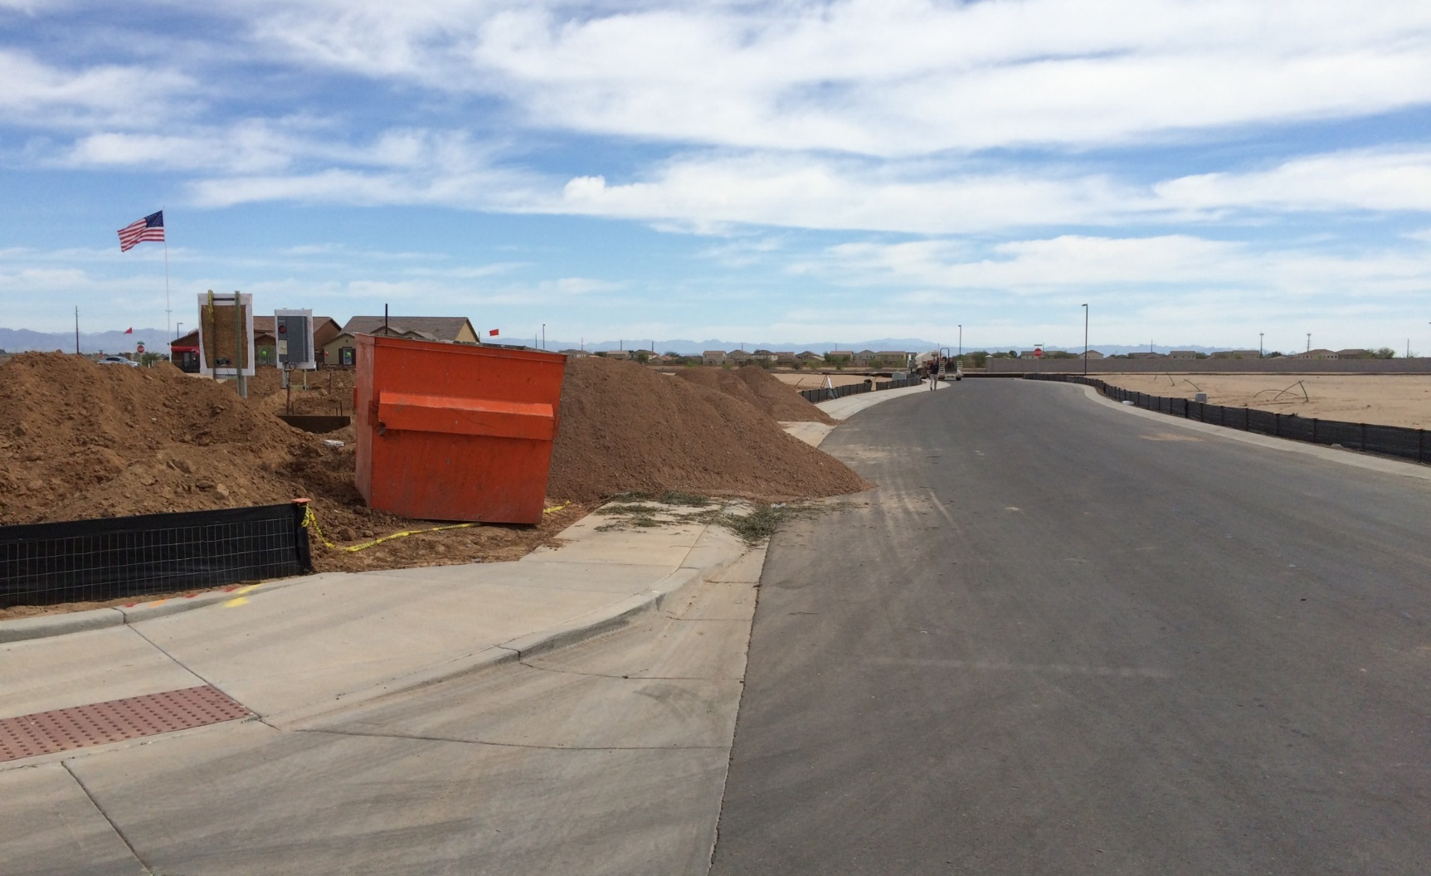

Slide 32
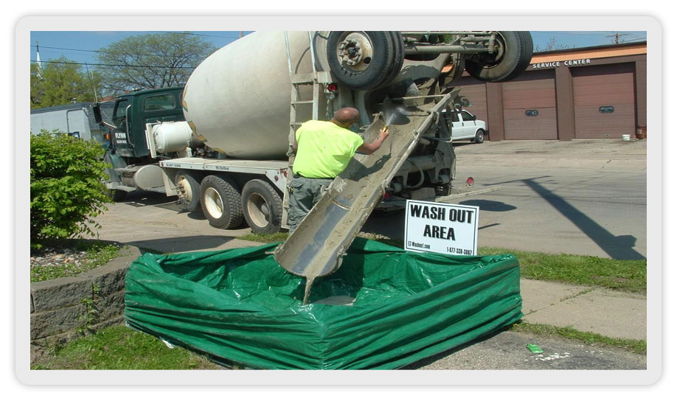
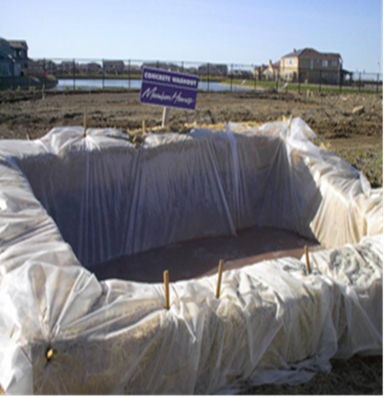
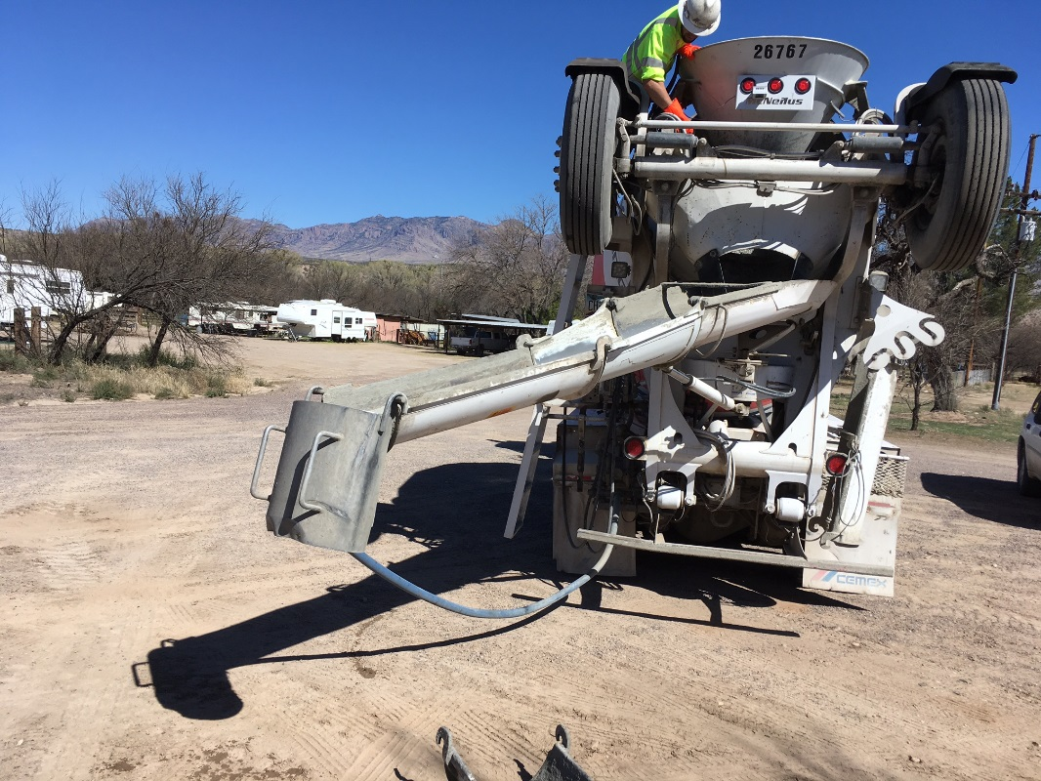
Concrete Wash Out

Slide 33
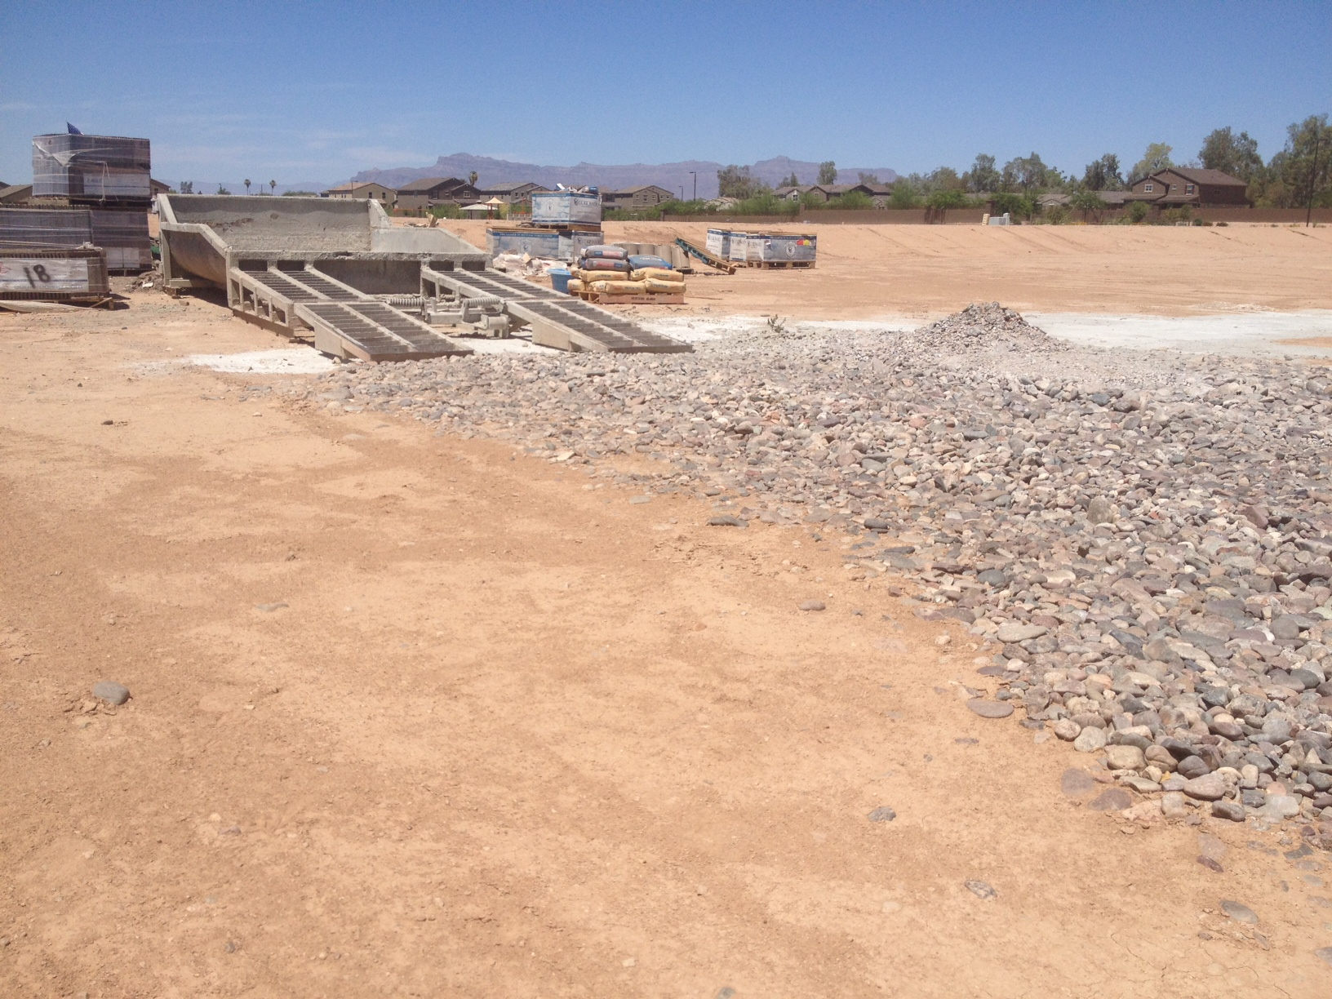
Pile of material & wash-out runoff

Slide 34
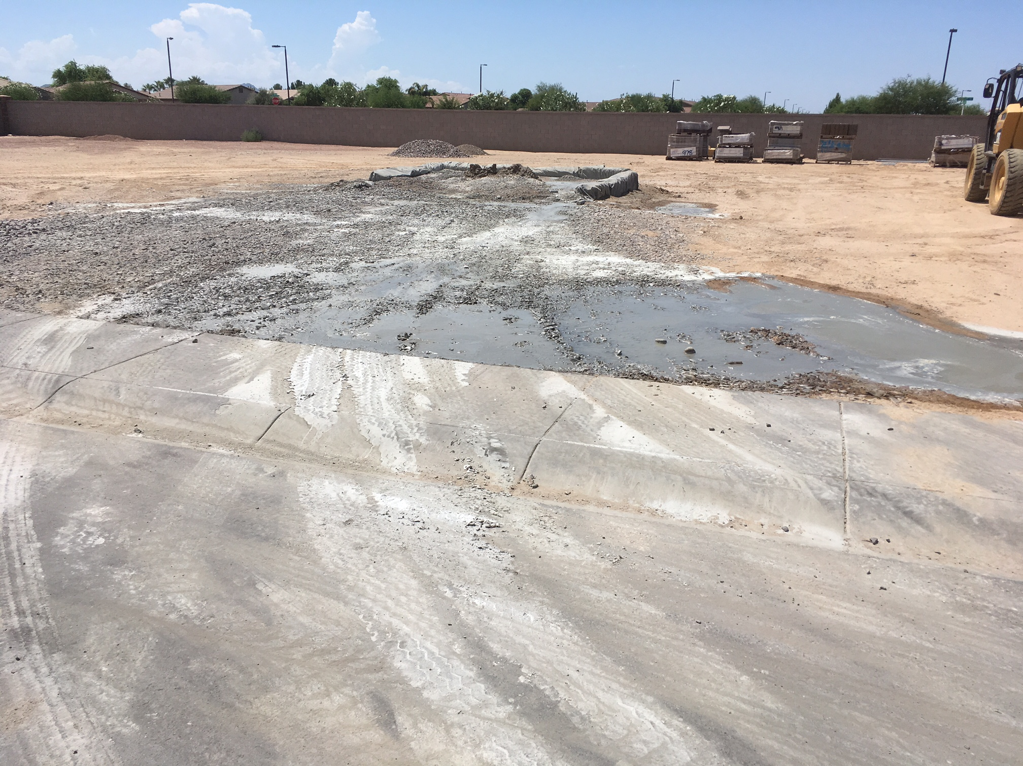

Slide 35
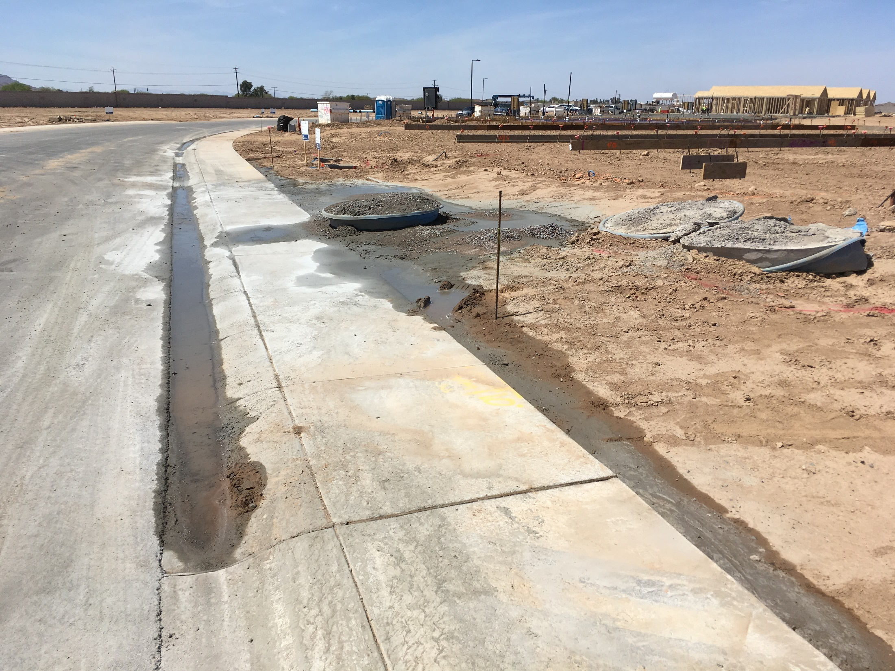

Slide 36
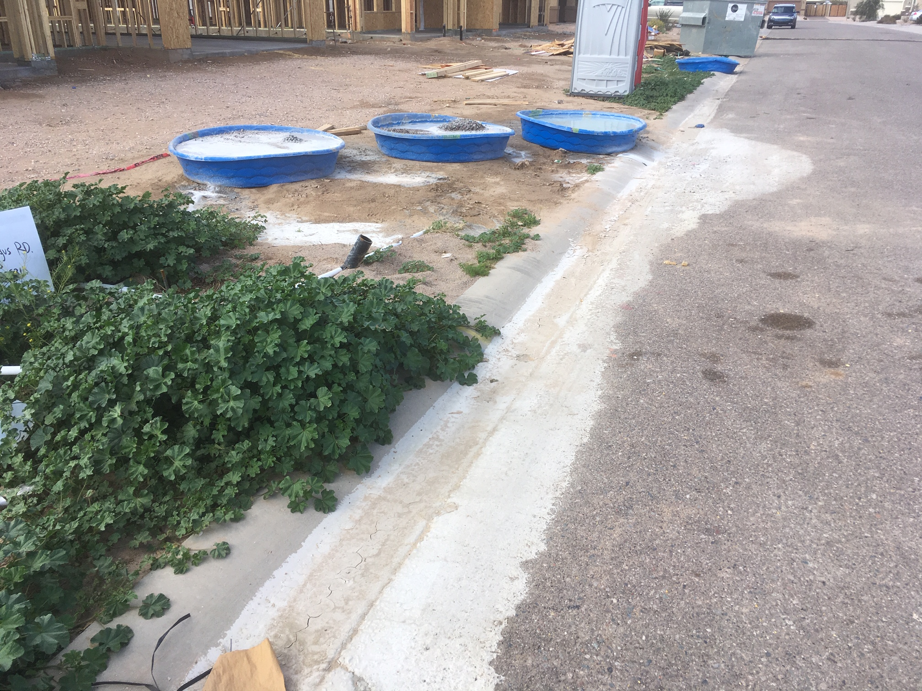

Slide 37
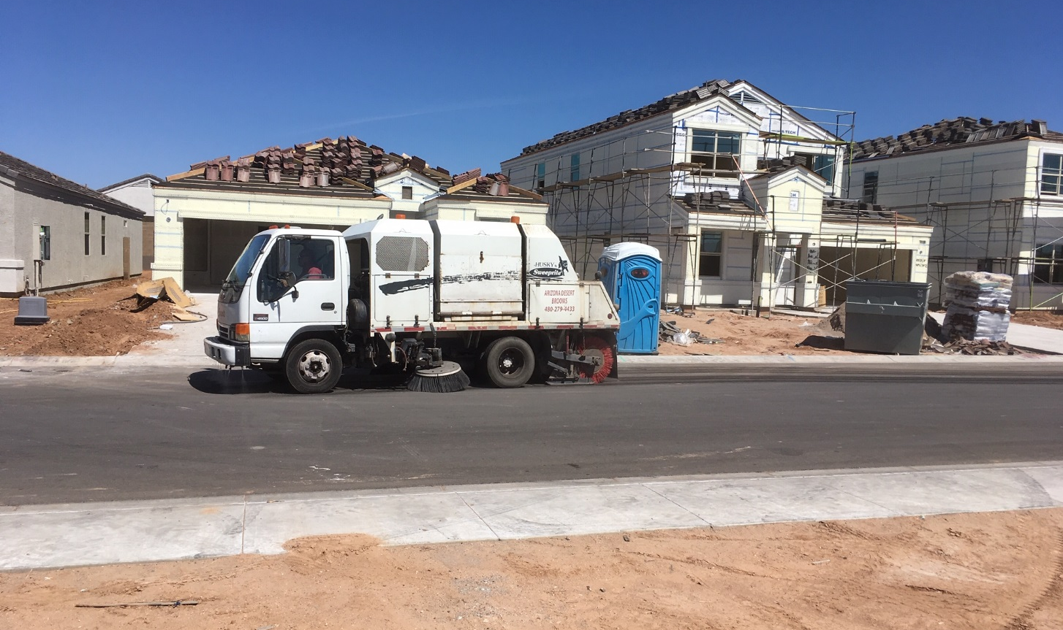
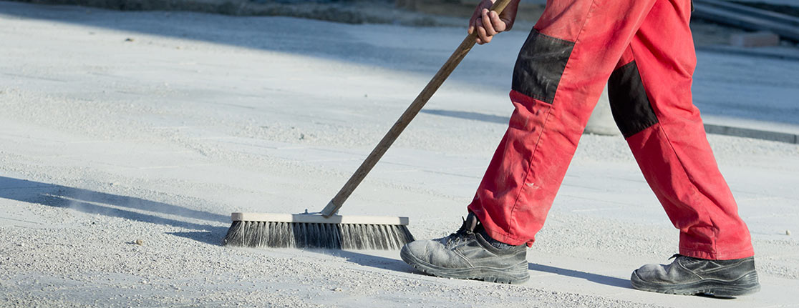


Streets carry stormwater.
It should be swept up if it can be carried away by stormwater.

Slide 38
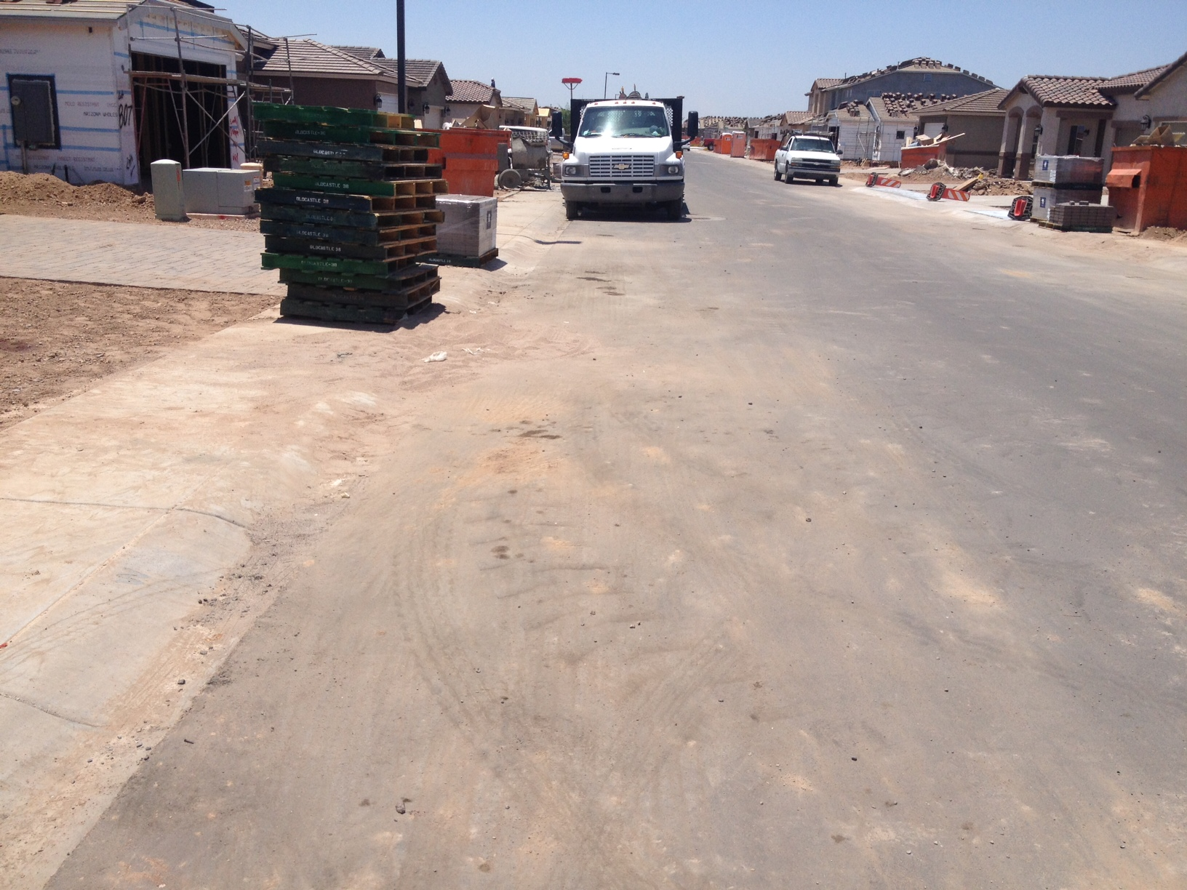
Dirty Work Site
> Lots of dirt/materials in
streets that will be
carried by stormwater

Slide 39
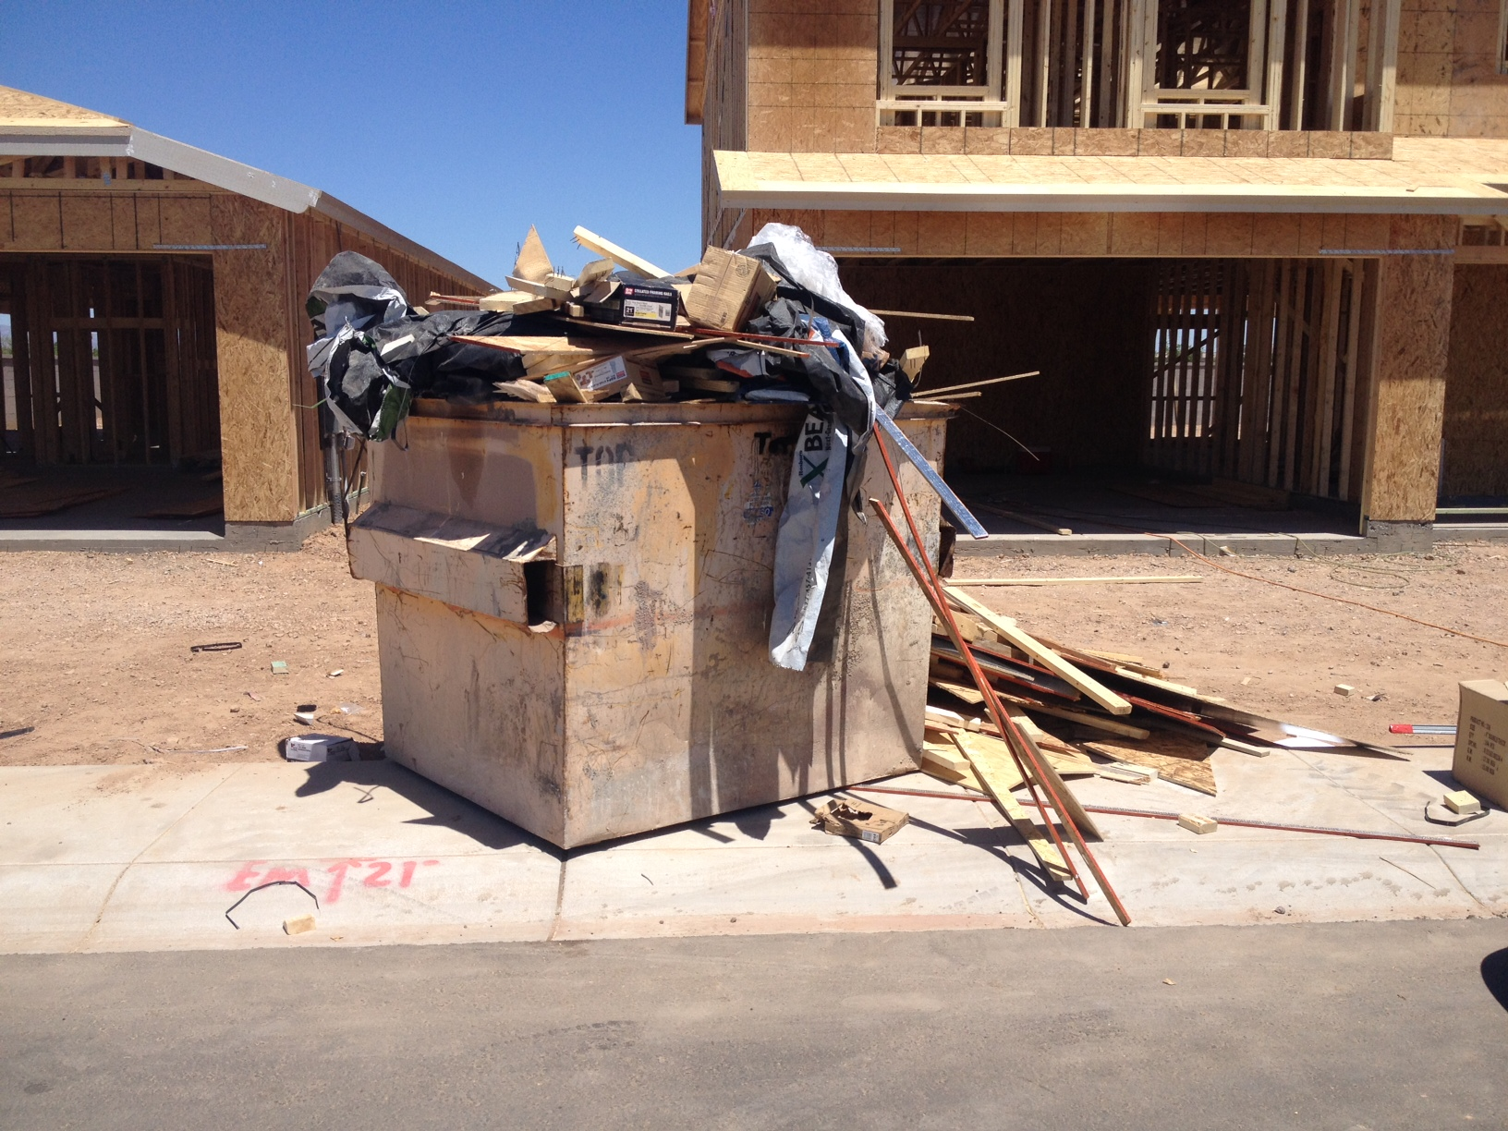

Slide 40
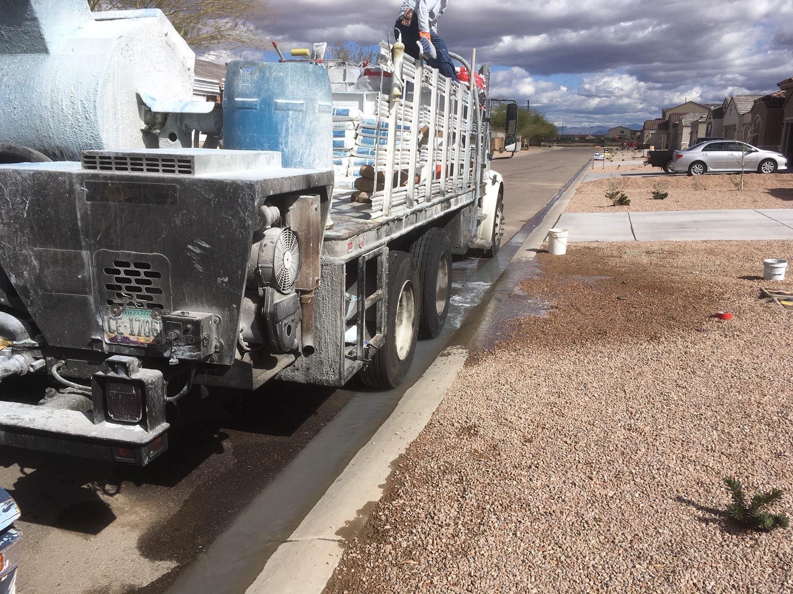
What are other contractors doing on your construction site?

Slide 41
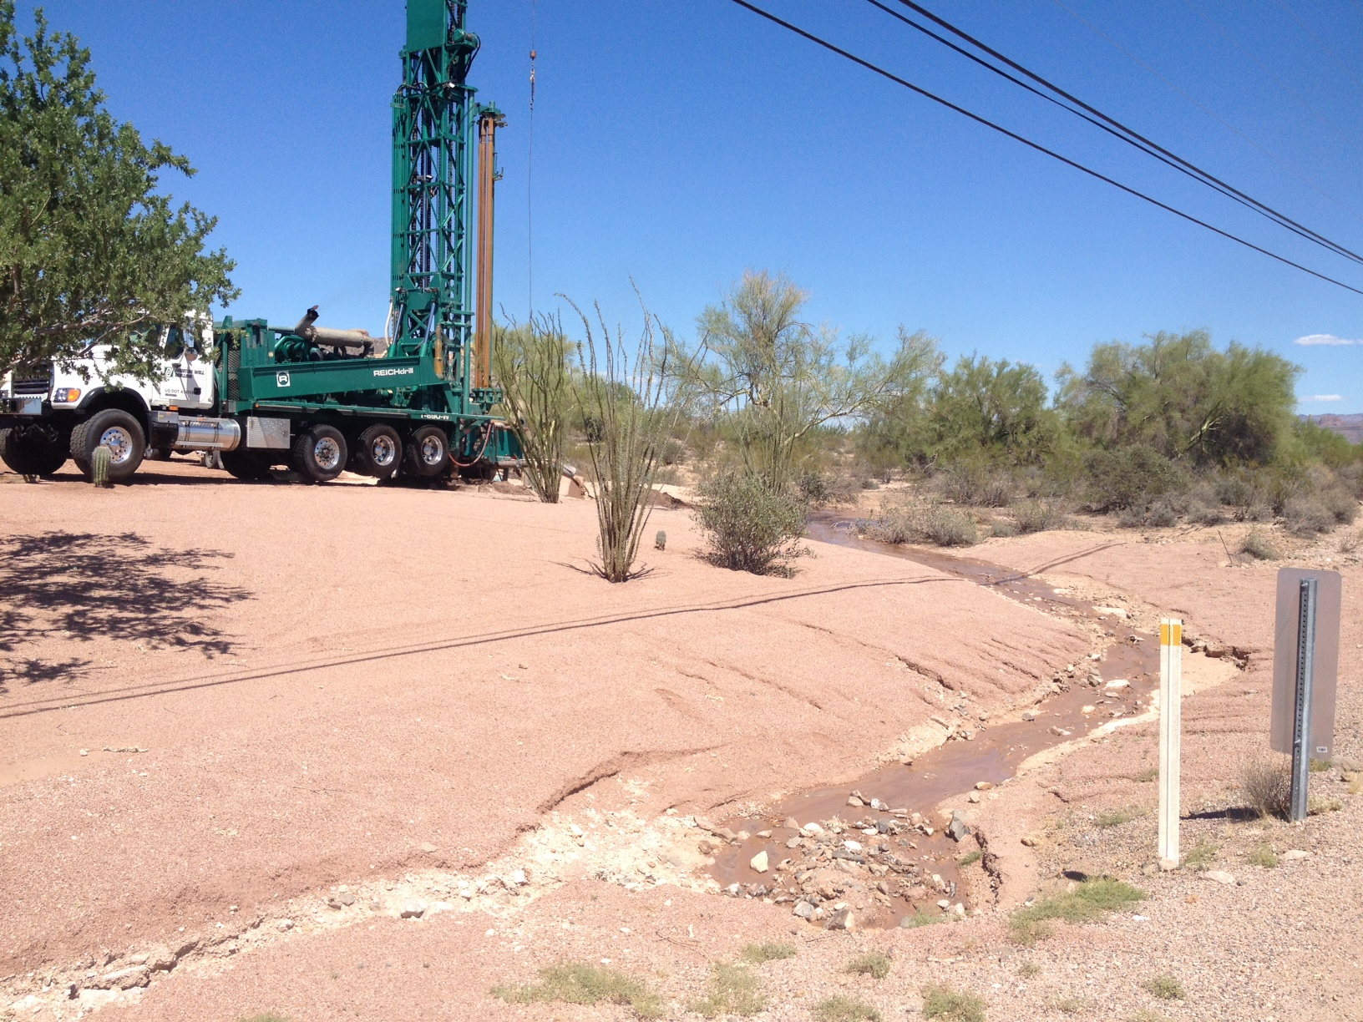
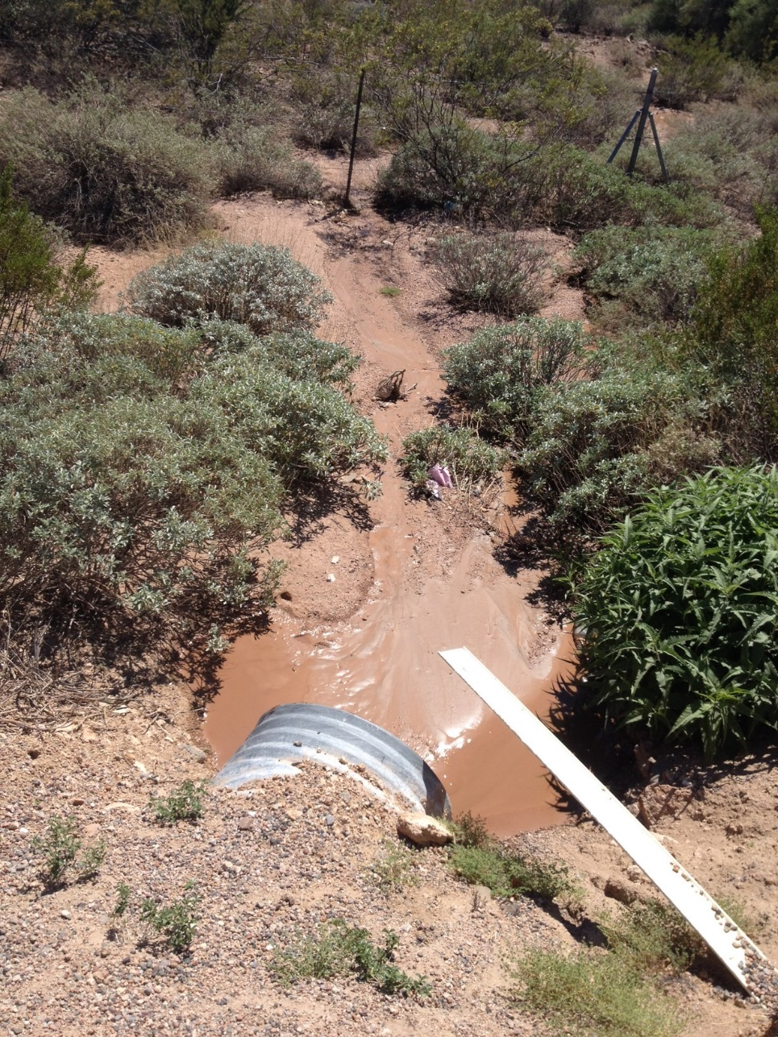
Domestic Well drilling discharging cuttings into a wash

Slide 42
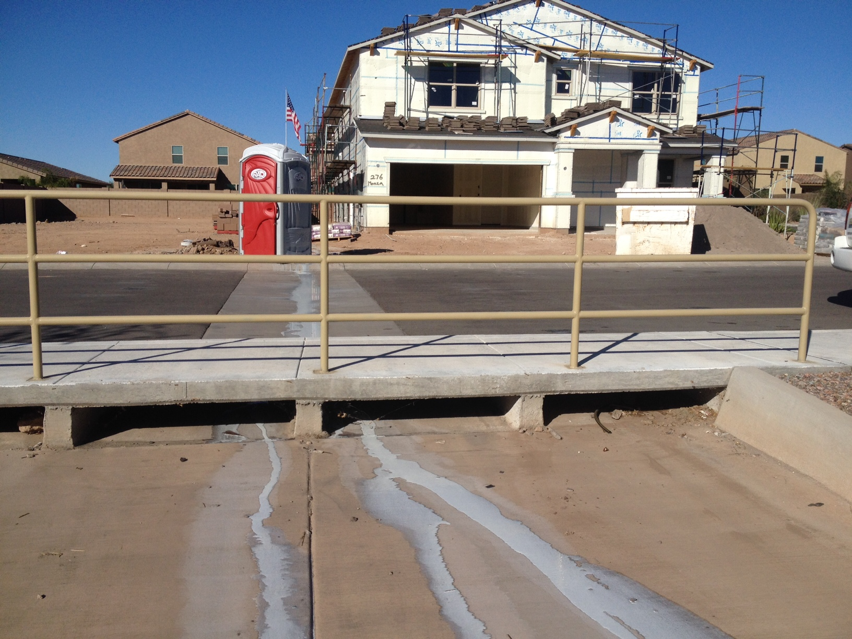
Educate sub-contractors

Slide 43
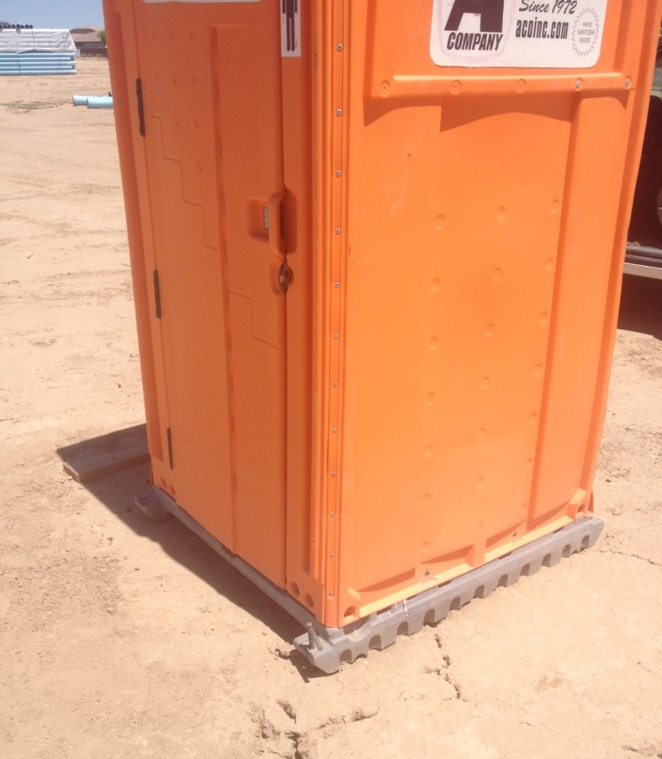
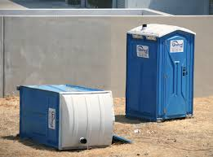
➔
Porta-John is staked down for added tip protection
➔

Slide 44
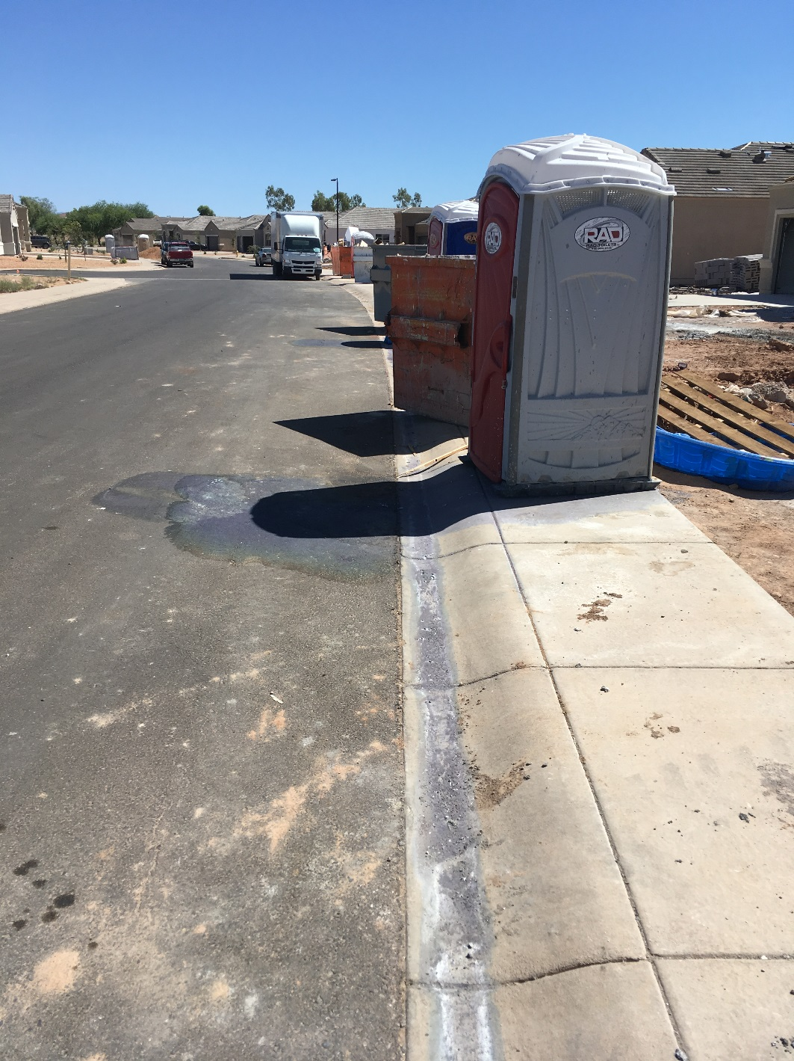
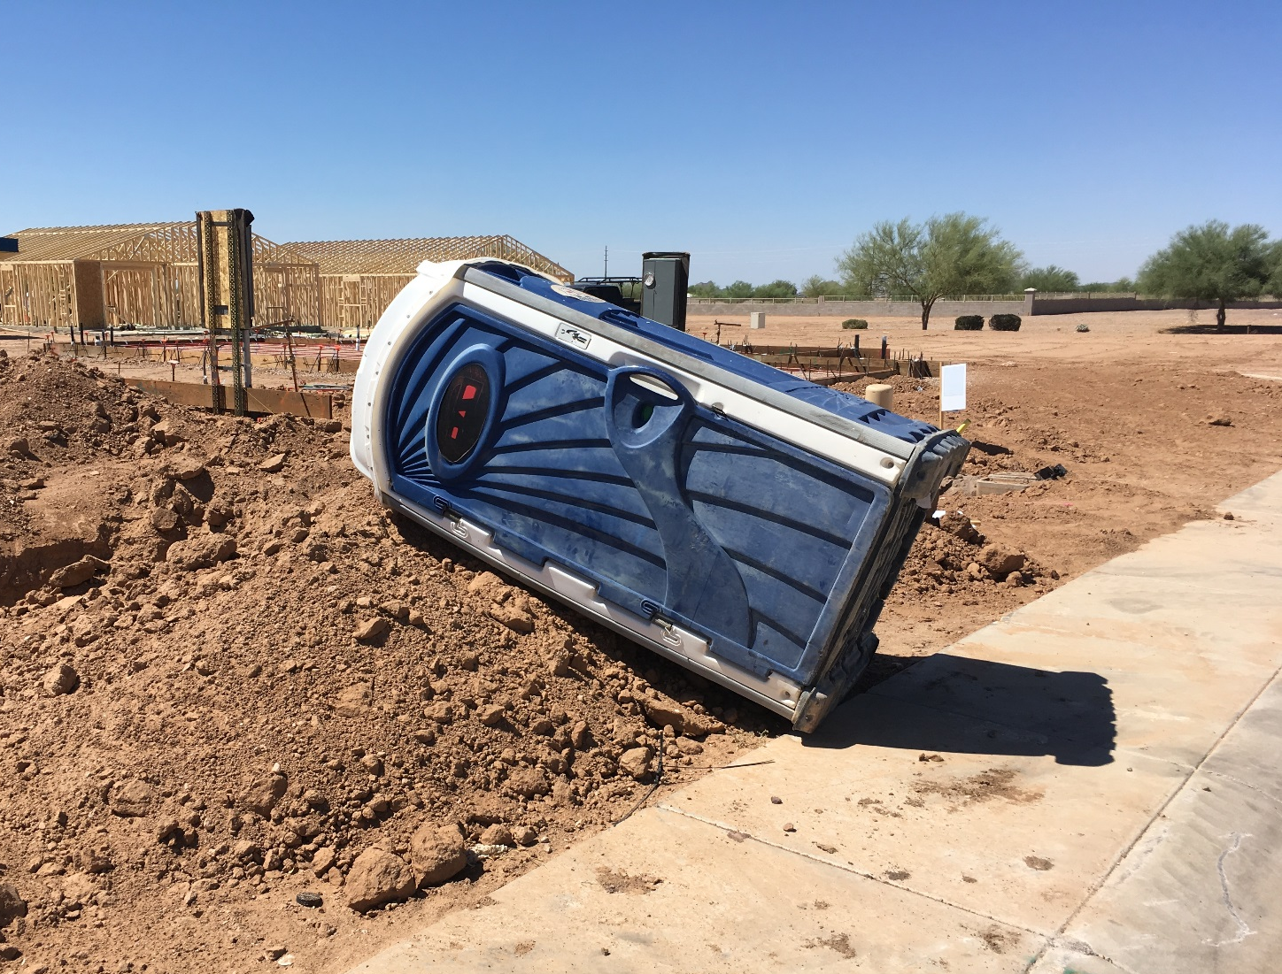

Slide 45
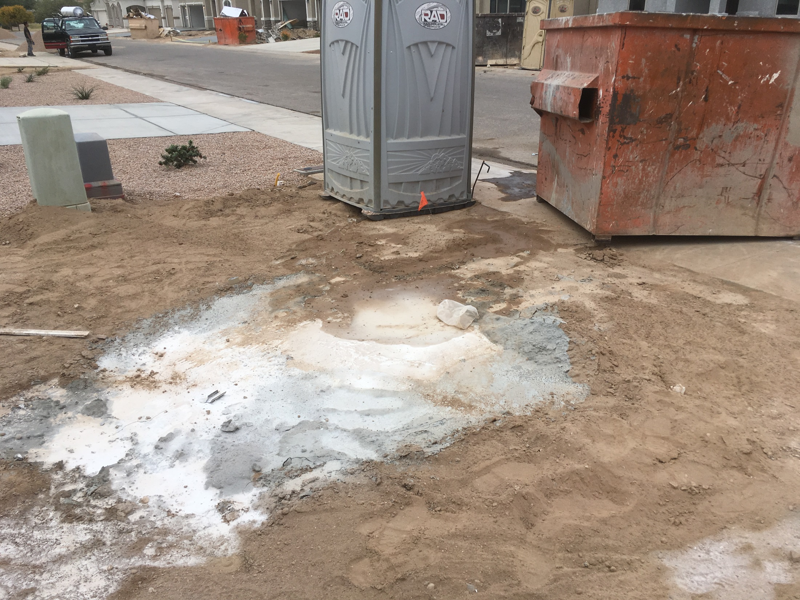
?
?
?

Slide 46
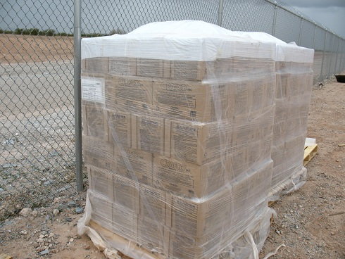
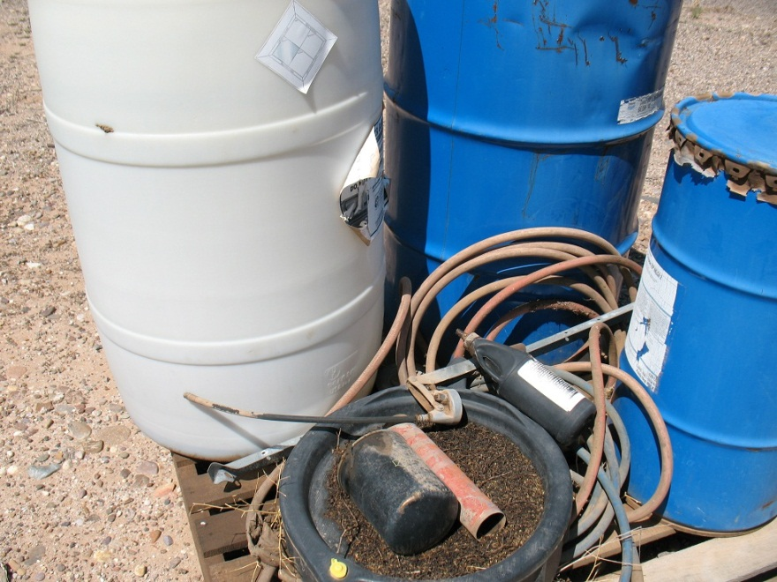
Hazardous Materials are secured and protected from rain

Slide 47
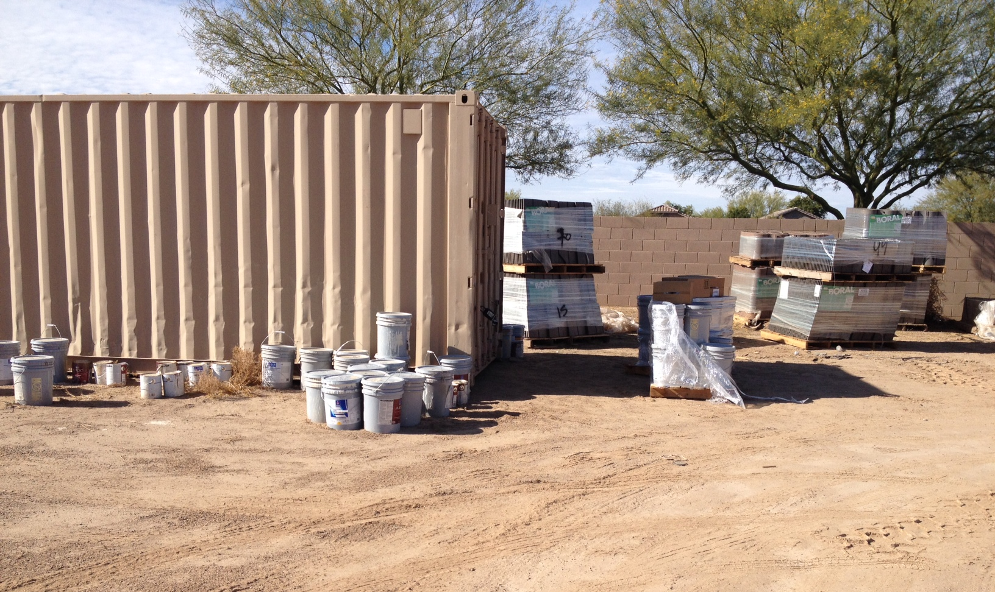

Slide 48
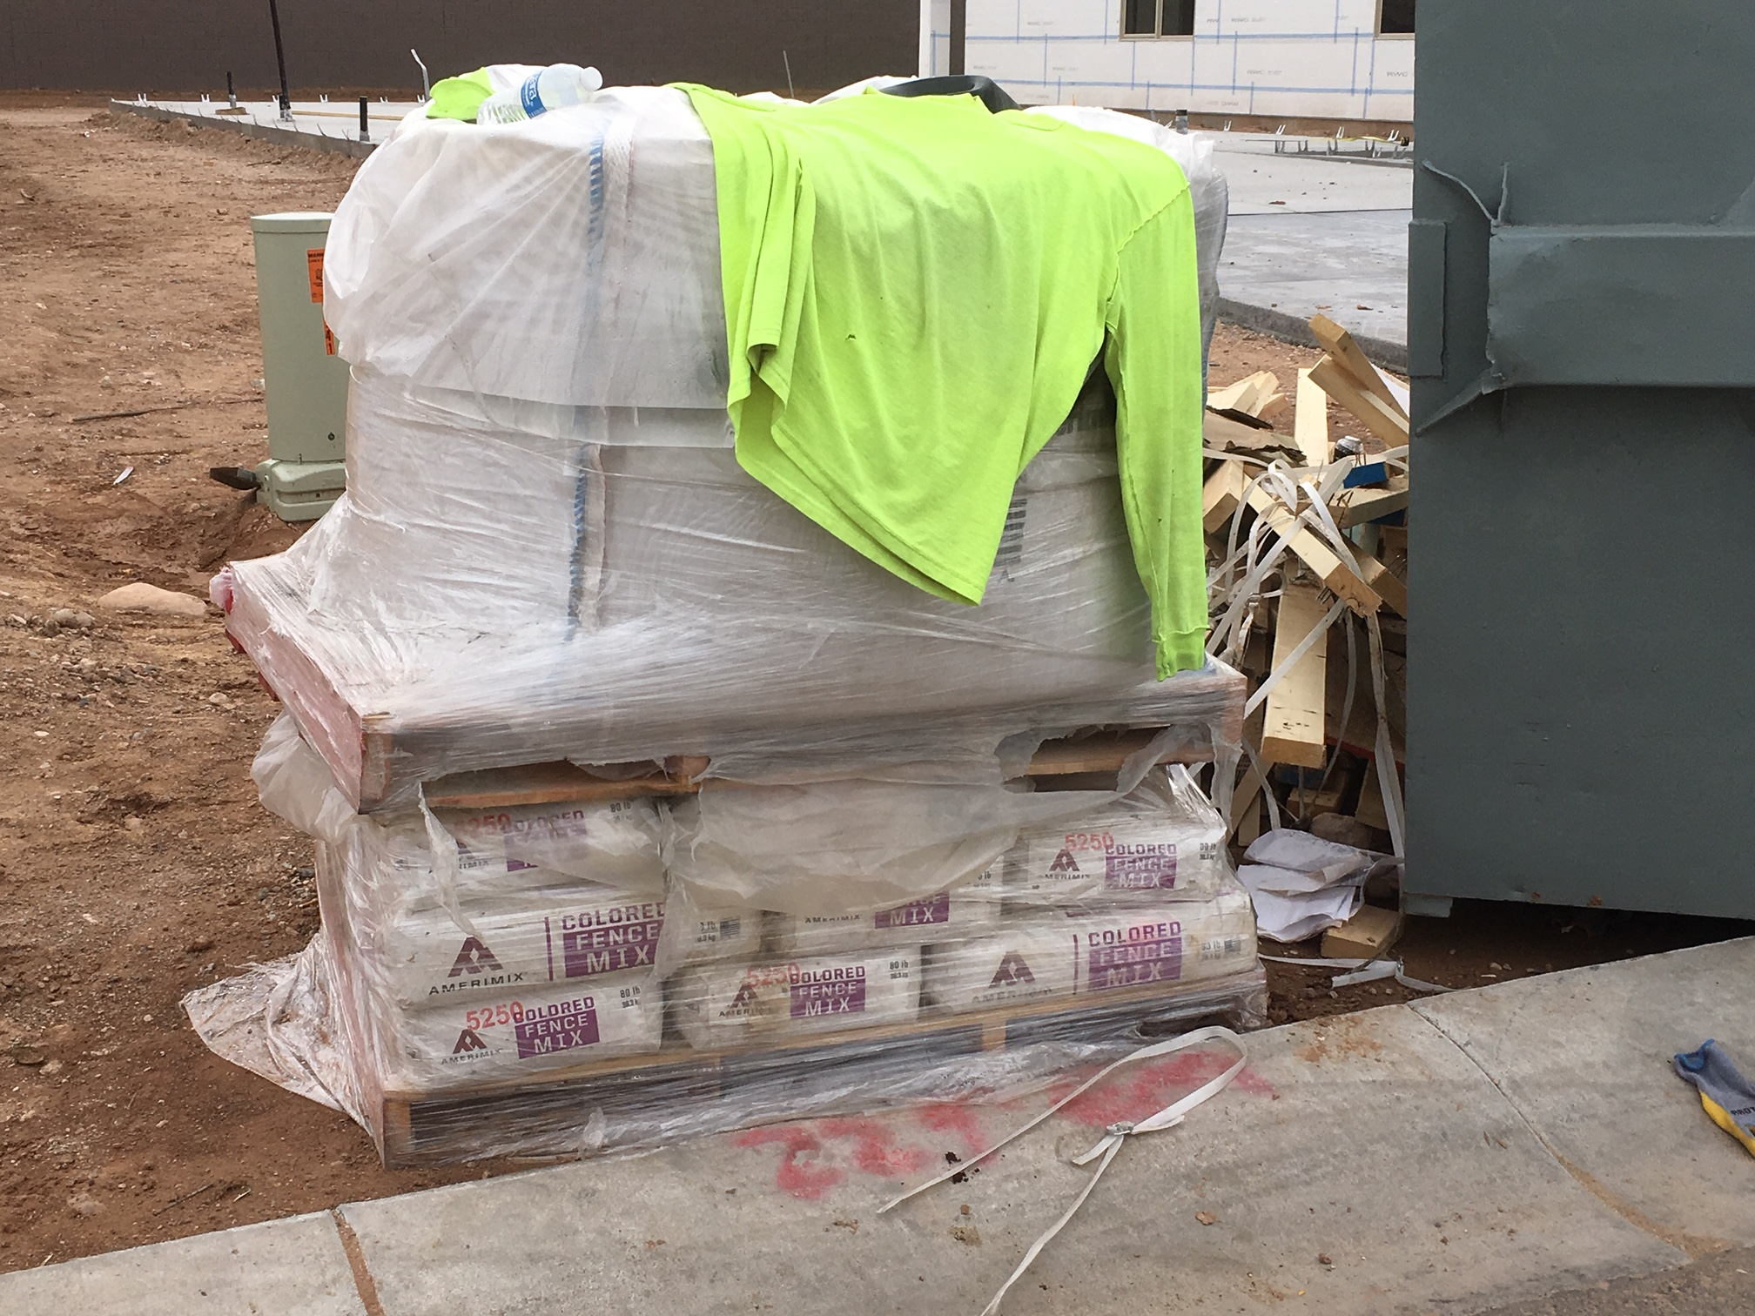

Slide 49
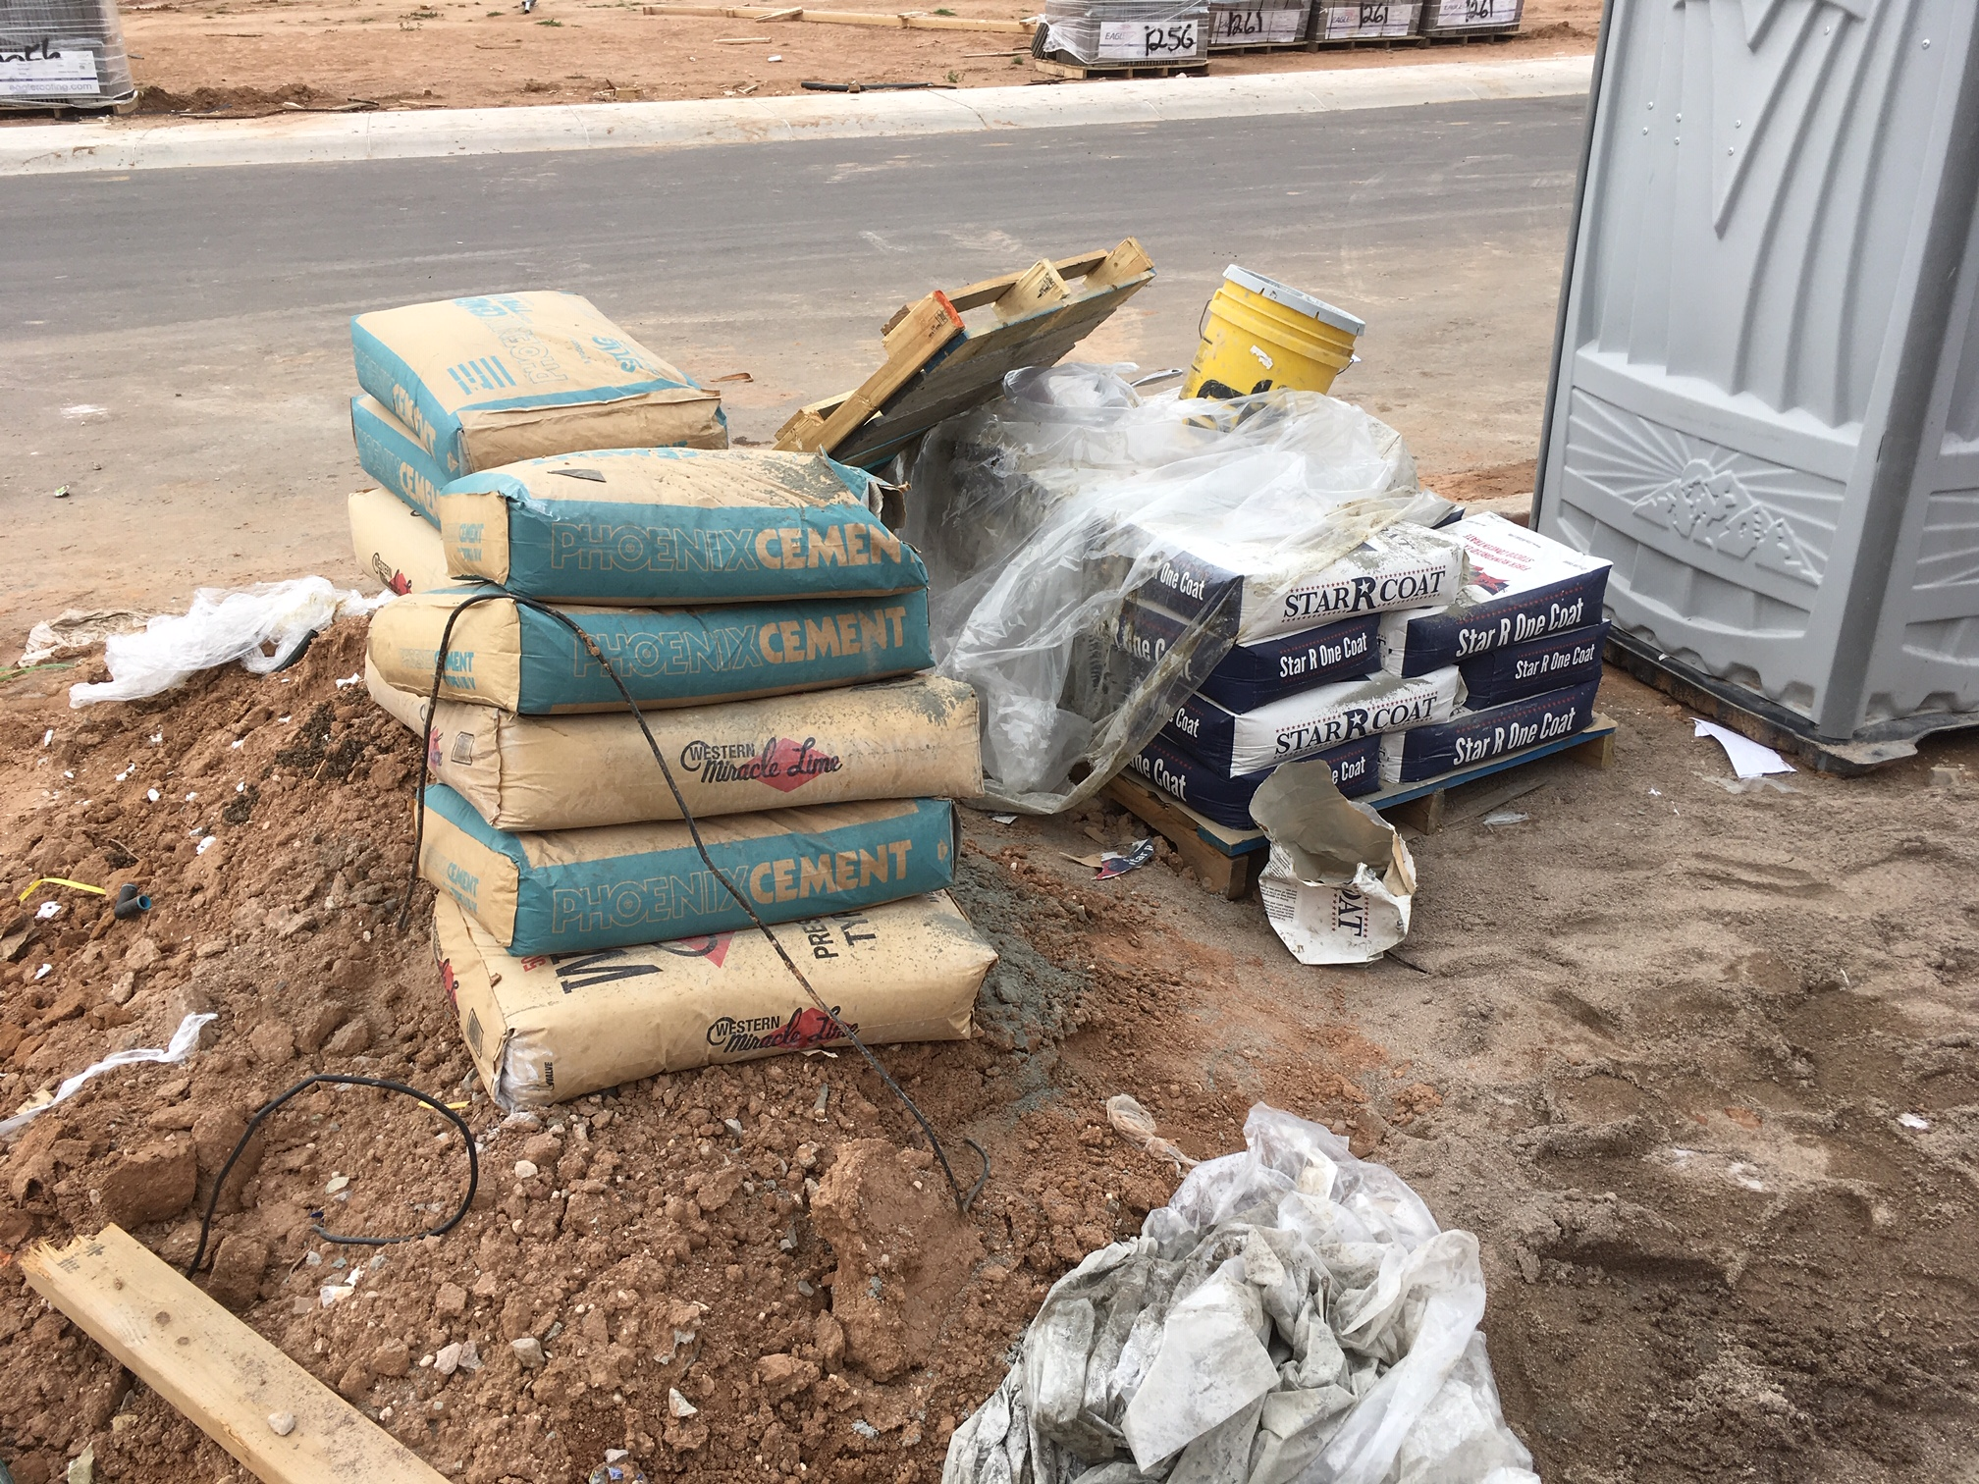

Slide 50


Secondary Containment:
110% of the largest container

Slide 51


Slide 52





Track-Out Control

Slide 53


Slide 54


Slide 55


Slide 56

Questions?

Slide 57

STORMWATER CONSTRUCTION VIOLATIONS
March 6, 2019
Stormwater Outreach for Regional Municipalities

Slide 58

Topics for this presentation
We are all the regulated community
Most common violations from an MS4 perspective
Why SWPPPs matter
Violations cited most often

Slide 59

Any Violations Here?

Slide 60


Slide 61

ADEQ Template for SWPPP
68 pages long – site specific
Construction companies have to add the information (who, what, how?)
Training for those working on the site

Slide 62

Stormwater Inspections (including complaints and what we saw from the street)
What will inspectors check for?
When is it a violation?
Our preference is to find NO VIOLATIONS, but here they are:

Slide 63


SWPPPS –
Staff doesn’t know where it is or what it says
BMPs in SWPPP don’t match up to the controls needed on site, and/or out of date
Municipalities are concerned with lack of compliance that can lead to pollutants entering our MS4s, not enforcing the Construction General Permit
Remember the SWPPP is a living, changeable set of instructions that you can and should change to fit your site!

Slide 64


Storm drain inlet protection
Inlet protection is a primary BMP. No erosion controls or additional sediment controls are also in place
The inlet protection blocks the storm drain or causes flooding
Sediment accumulation not removed after each storm
“Gaps” allow unfiltered stormwater to enter the inlet

Slide 65


Construction Exits
Evidence of sediment track out
Evidence that vehicles aren’t using the designated construction exits
Aggregate needs to be replaced or replenished
Construction exit not long enough to remove mud from tires
Note: Track out violations are regulated by both Stormwater and Air Quality regulators!

Slide 66


Silt Fences and Sediment Barriers
No silt fence or sediment barrier, with potential for material to enter MS4
Controls not maintained
Sediment not removed when it reaches 1/2 the height of the barrier
Sediment barriers used as check dams or where concentrated flow is expected

Slide 67


Concrete Washout
No containment system
Discharged into sanitary or storm drain
Washout containment in poor repair
Not serviced – more than 75% full

Slide 68



Potential Pollutant Storage
Simple:
No Secondary Containment
No Cover

Slide 69


Vegetative Stabilization – These are tough for MS4s to enforce, often contractual
Exposed soil areas not stabilized.
Signs of erosion
Method chosen for stabilization just doesn’t work

Slide 70

Abandoned Construction Projects
These are also tough for municipalities. Will start with holding property owner responsible.
Temporary controls left in place. Potential violations are those that impact stormwater flow
Soil disturbance could result in pollutant to MS4
Contractor responsible for maintaining until NOT filed

Slide 71

Conclusions
Violations slow down progress and are not in anyone’s best interest. We all have common goal of getting your project in place and in business.
Contact the agency (city, county or other MS4) you’re working in for specific requirements, or consultation.
Follow your SWPPP!
This Photo by Unknown Author is licensed under CC BY-SA-NC

Slide 72
STORMWATER CONSTRUCTION ENFORCEMENT
Richard Dalton
City of Tempe
Environmental services Section
richard_Dalton@tempe.gov

Slide 73

Enforcement
Authority
Permit
SWPPP
Enforcement Response Plan

Slide 74


Enforcement
Priorities
Procedures
Records
Training
Reporting

Slide 75



Authority
Clean Water Act
State
Local code
Permit

Slide 76




Permit
Cites authority
Expectations
Obligations
SWPPP

Slide 77


SWPPP
Site description
Maps
Control measures
Source summary
Chemicals
P2 procedures
Inspections
Documentation

Slide 78
Inspection
Evaluated on site specific basis with items most likely to impact stormwater quality inspected first.
Tempe requires projects greater than one acre to file an Notice of Intent with ADEQ (CGP), and develop a Stormwater Pollution Prevention Plan (SWPPP).
Tempe Inspectors looking for conditions with potential to impact the MS4.
  SWPPP

Slide 79

Inspections
MS4’s are organized differently.
Inspectors may check for different things.
  Scope/Specific purpose
These two look good, not perfect.

Slide 80

Inspections
The right to inspect sites is in City Code.
Access to premises, records and monitoring.
Administrative warrants if necessary.
The first step in enforcement.
  Starts and Stops here

Slide 81



Post construction controls
All temporary control measures must be removed.
Property owners must ensure proper operation and maintenance of stormwater control mechanisms.

Slide 82
Enforcement
Some include sites that are less than one acre.
MS4’s can require specific BMPs be submitted and approved
Cease & Desist
Criminal

Slide 83




Stop order
7/05: Inspector noticed deficiencies from street.
Contacted Grading & Drainage permit holder.
7/12 Onsite inspection with Stop Work Order.
7/13 Response letter from developer.

Slide 84


Slide 85


Enforcement Reponses Plan
Required
  MS4 permit
Consistent
Complete
Escalating

Slide 86

Enforcement response steps
Inspection
Warning
Notice of Violation/Administrative Order
Consent Orders
Civil/Criminal Penalties

Slide 90

Final Thought
Control the process
Show Cause
Standard of proof

Slide 91




Slide 92


